Slide 1
Introduction to Computer Science
William Hsu
Department of Computer Science and Engineering
National Taiwan Ocean University
Notes:
54

Slide 2
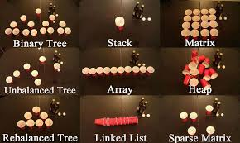
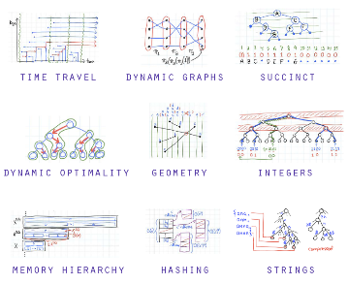
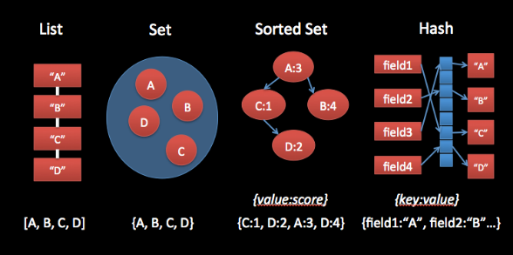
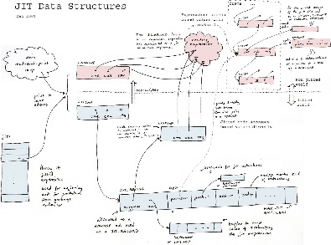
Chapter 8: Data Abstractions
LIFO (Last In, First Out) Also called a "stack".
FIFO (First In, First Out) Also called a "queue".
FISH (First In, Still Here) Also called a "hung printer".
FIGL (First In, Got Lost) Also called a bureaucracy.
LIGL (Last In, Got Lost) Also called a "streams module".
FIGO (First In, Garbage Out) Also called a "random number generator".
GHNW (Got Here, Now What?) Also called a "longjmp botch".
Notes:
LIFO (Last In, First Out) Also called a “stack”. 後進先出 堆疊
FIFO (First In, First Out) Also called a “queue”.先進先出 佇列
54

Slide 3
8.1 Basic Data Structures
8.2 Related Concepts
8.3 Implementing Data Structures
8.4 A Short Case Study
8.5 Customized Data Types
8.6 Classes and Objects
8.7 Pointers in Machine Language
Notes:
54

Slide 4
Basic Data Structures
Arrays
Aggregates
List
Stack
Queue
Tree
Notes:
54

Slide 5
Lists, Stacks, and Queues
2014/8/29
2
Notes:
List 就是清單，像是人名列表，並且有頭尾之分
Stack 堆疊，可以想像成一堆書疊在一起，有最底層跟最上層，如果你想拿書或堆書，正常人都會從最上面拿或堆，很少有天賦奇才的人會從下面拿或堆
Queue 佇列，就像是我們要排隊買票，有頭尾之分，在正常情況下一定是先排隊的人先買到票，並且排隊都從後面排
54

Slide 6
Terminology for Arrays
Array: A block of data whose entries are of same type.
A two dimensional array consists for rows and columns.
Indices are used to identify positions.
2014/8/29
2
Notes:
Array 陣列，一整個區塊的資料都屬於同一種資料型態
有兩個維度的陣列他會有rows(行)跟columns(列)
Indices索引，也就是例如[1][2]之類的 是被用來辨別位置的
54

Slide 7
Terminology for Aggregates
Aggregate: A block of data items that might be of different type or sizes.
Each data item is called a field.
Fields are usually accessed by name.
2014/8/29
2
Notes:
Aggregate 表示有一個區塊的資料物件可能有不同的資料型態或大小
所有的資料物件都被稱為一個field
通常是用名稱來訪問fields
54

Slide 8
Terminology for Lists
List: A collection of data whose entries are arranged sequentially.
Head: The beginning of the list.
Tail: The end of the list.
2014/8/29
2
Notes:
List 為一個所有元素都按照順序排列好的資料集合
Head 是list的開頭
Tail 是list的結尾
可以用畫圖來增加理解
54

Slide 9
Terminology for Stacks
Stack: A list in which entries are removed and inserted only at the head.
LIFO: Last-in-first-out.
Top: The head of list (stack).
Bottom or base: The tail of list (stack).
Pop: To remove the entry at the top.
Push: To insert an entry at the top.
2014/8/29
2
Notes:
Stack 是一種list，但你想搬移或加入資料只能從他的頭來做動作
這個規則稱為Last-in-first-out，後進先出
還記得前面提過的書堆?我們不是有提過你想要加入或拿走書，都只能從最頂端拿?，他的最頂端用list來看的話就是list的head了
而最底端則是list的尾巴了
Pop表示我們將物件從list裡面拿走，在堆疊這邊是將最頂端的物件移走
Push表示我們將物件加入list，在堆疊這邊是將物件從最頂端加入
畫圖可以幫助理解
54

Slide 10
Terminology for Queues
Queue: A list in which entries are removed at the head and are inserted at the tail.
FIFO: First-in-first-out.
2014/8/29
2
Notes:
Queue則是要移除物件只能從head移除，而加入則只能從尾巴加入
又稱為first in first out
畫圖可以增加理解
54

Slide 11
Terminology for a Tree
Tree: A collection of data whose entries have a hierarchical organization.
Node: An entry in a tree.
Root node: The node at the top.
Terminal or leaf node: A node at the bottom.
Parent: The node immediately above a specified node
Child: A node immediately below a specified node
Ancestor: Parent, parent of parent, etc.
Descendent: Child, child of child, etc.
Siblings: Nodes sharing a common parent.
2014/8/29
11
Notes:
樹有以下這些術語
Tree是有層次結構的資料集合
Node是指tree這個集合裡面的元素
RootNode是指tree的最頂端
Terminal or leaf node 則是指樹裡面最底層的元素
Parent則是指某個節點上面一位的元素
Child則是指某個節點下面一位的元素
Ancestor則是指某個節點上面跟他有相連的所有元素
Descendent是指某個節點下面跟他相連的所有元素
Sibling則是指跟某個節點有共同Parent的元素
畫家族圖來增加理解
54

Slide 12
Terminology for a Tree (continued)
Binary tree: A tree in which every node has at most two children.
Full Binary Tree
Complete Binary tree
Depth: The number of nodes in longest path from root to leaf.
2014/8/29
11
Notes:
畫圖來理解
Binary tree 是一個樹他每個元素最多有兩個子節點
Depth深度，代表從root到達那個節點的最長距離
54

Slide 13
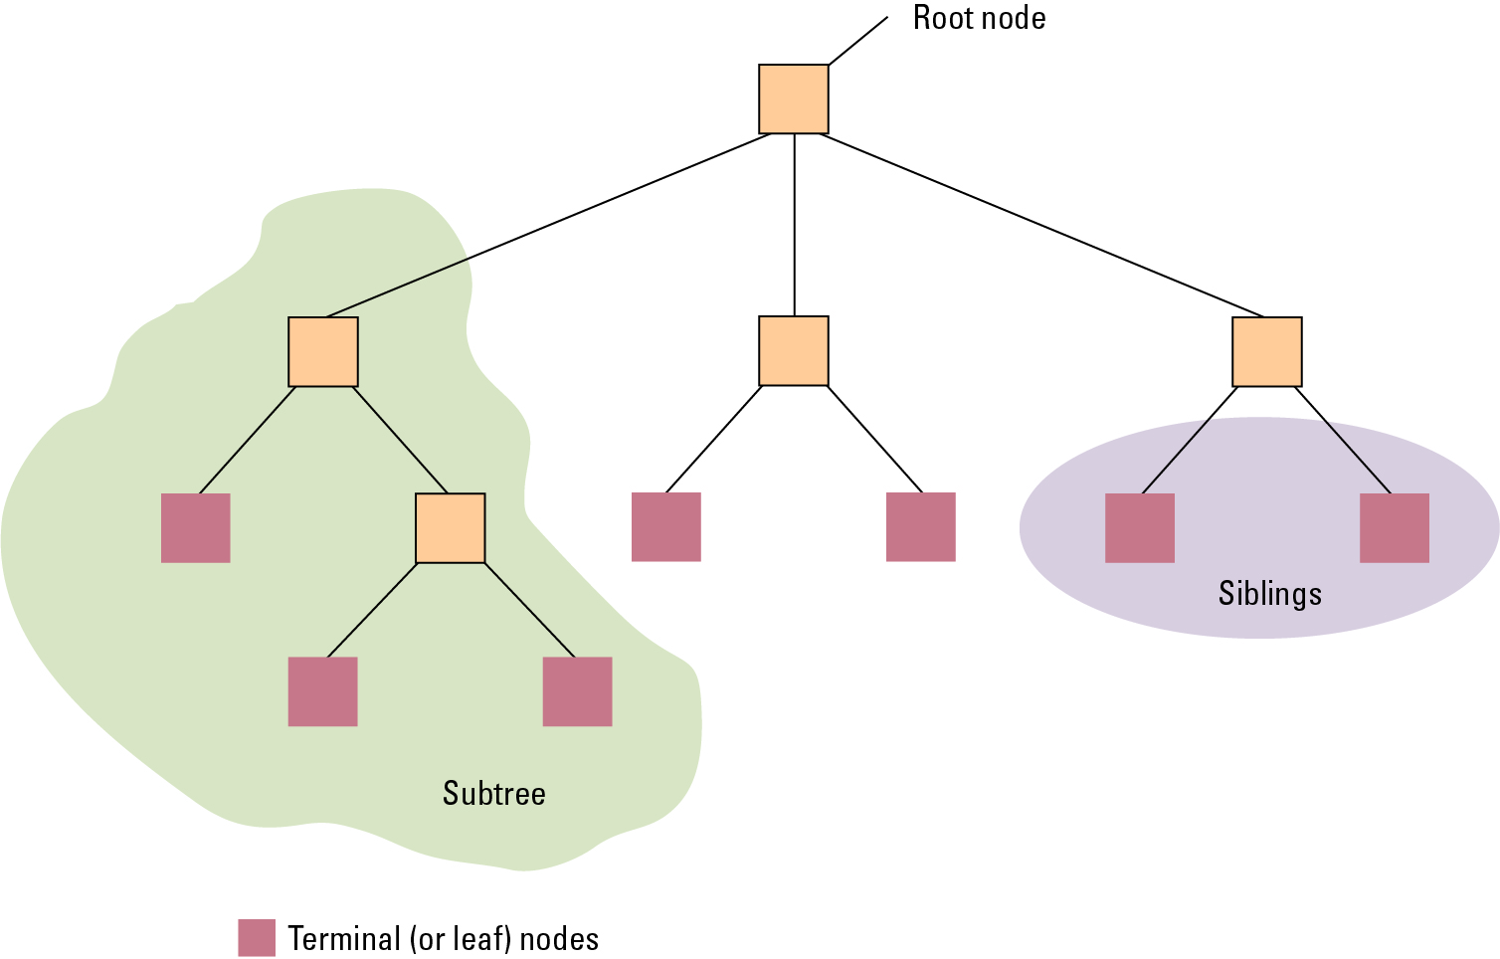
Tree Terminology
2014/8/29
11
Notes:
54

Slide 14
Related Concepts
Abstraction
Shield users (application software) from details of actual data storage.
Static vs. Dynamic Structure
Does the shape and size change over time?
Pointer
A storage area that encodes an address where data is stored
Later used to access the data.
2014/8/29
11
Notes:
抽象化-應用軟體不用知道實際上資料運作的細節
靜態結構vs動態結構
形狀和大小會隨著時間改變嗎?
Pointer
-為一個資料儲存的區域，被編碼成一個位址，
-後面被用來訪問資料
54

Slide 15
Novels Arranged by Title but Linked According to Authorship
2014/8/29
11
Notes:
小說按照標題排列但是用作者身分鏈結
先依照字典排序排好小說名子，在依照同一作者將小說資料做連結，中間空格的部分就是其他小說的部分
54

Slide 16
Storing Arrays
Memory address of a particular cell can be computed.
Row-major order versus column major order.
Address polynomial.
2014/8/29
11
Notes:
用陣列來儲存list
特定元素的記憶體位置可以被計算出來
以行為主的順序vs以列為主的順序
地址多項式
M = 初始記憶體
Row A[I,j] = M + c * (i-1) + ( j - 1)
Col A[I,j] = M + (i-1) + r * (j - 1)
54

Slide 17
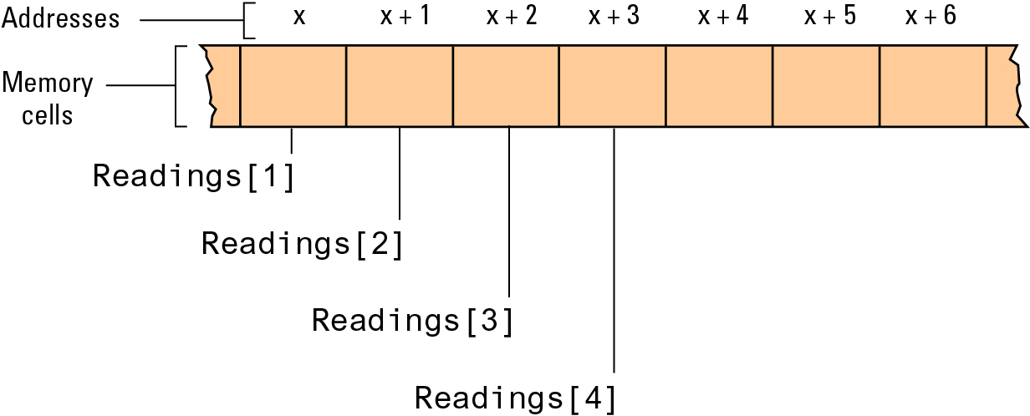
The Array of Temperature Readings Stored in Memory Starting at Address x
2014/8/29
11
Notes:
54

Slide 18
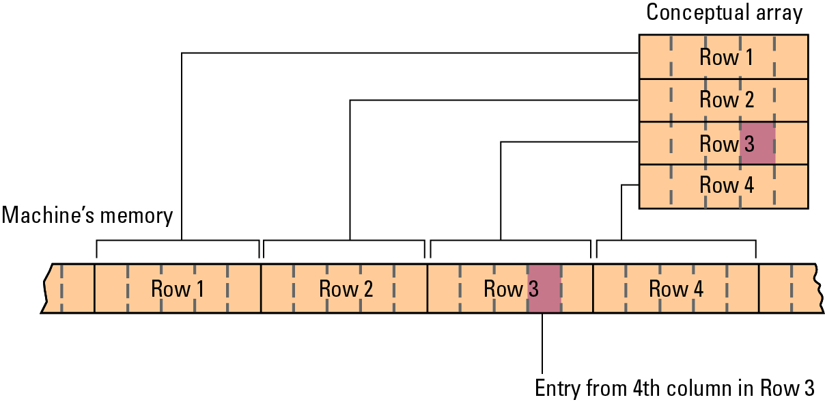
A Two-dimensional Array with Four Rows and Five Columns Stored in Row Major Order
2014/8/29
18

Slide 19
Storing Aggregates
Fields can be stored one after the other in a contiguous block:
Memory cell address of each field can be computed.
Fields can be stored in separate locations identified by pointers.
2014/8/29
18
Notes:
fields可以一個接著一個被儲存在連續的區塊中
-每個fields所在的Memory cell的位置都可以被計算出來
Fields也可以被儲存在不同的地點(不連續)，並且用指標識別
54

Slide 20
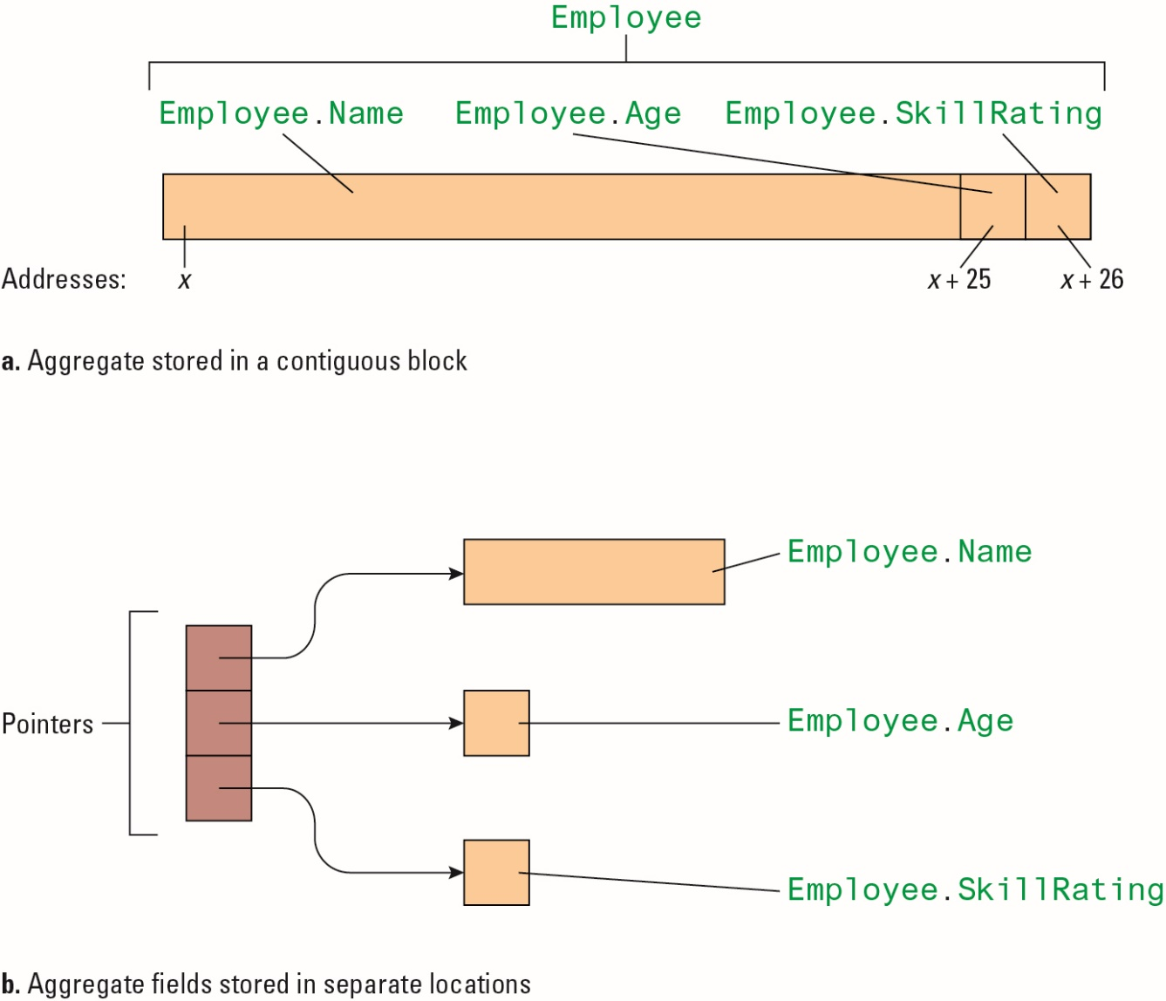
Storing the Aggregate Type Employee
2014/8/29
18

Slide 21
Storing Lists
Contiguous list: List in which entries are stored in an array.
Linked list: List in which entries are linked by pointers.
Head pointer: Pointer to first entry in list.
null: A “non-pointer” value used to indicate end of list .
2014/8/29
18
Notes:
Contiguous list: 用陣列來實作List，List中的每個field被存在陣列裡面
Linked list:串鏈結構，List中的每個field是用指標來連結，與Contiguous list不同的是他的記憶體位置可能不連續。
-Head pointer:list中的第一個field，也就是list的head，tree的root
-null:我們會用null來表是指向list的結尾，就像字串裡面會用\0來表示結尾
54

Slide 22
Names Stored in Memory as a Contiguous List
2014/8/29
18

Slide 23
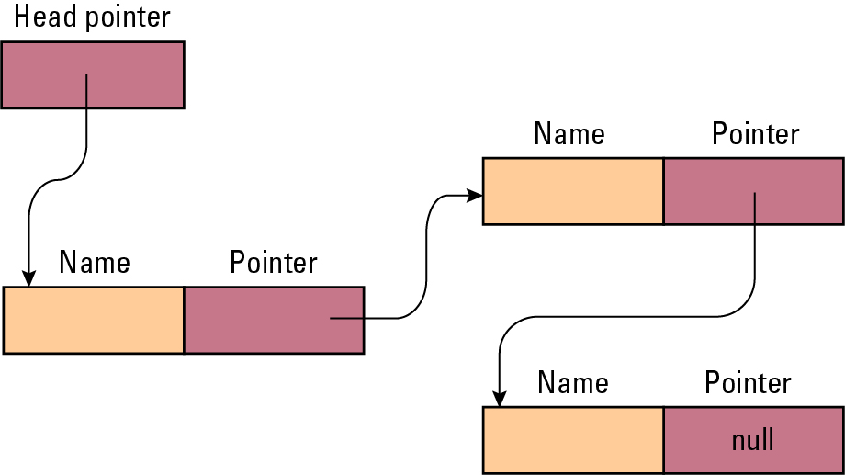
The Structure of a Linked List
2014/8/29
18
Notes:
串鏈結構的結構圖
54

Slide 24
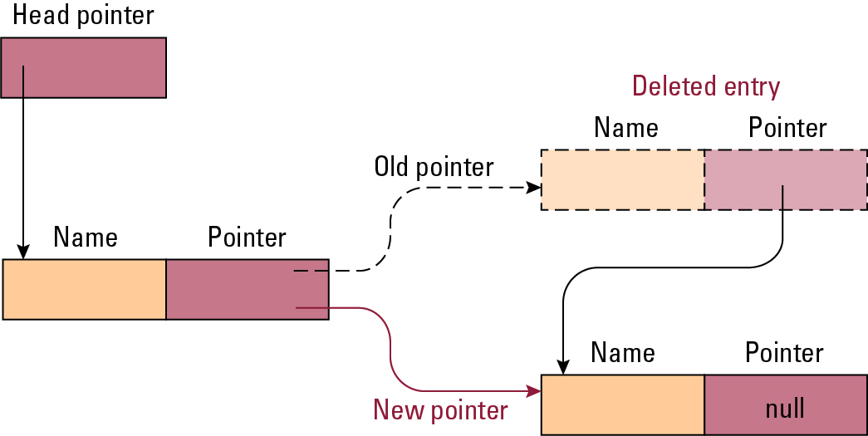
Deleting an Entry From a Linked List
2014/8/29
18
Notes:
如果我們刪掉其中一個Entry，必須將指向該Entry的前一個的Entry的指標指向被刪除的Entry所指向的Entry
以皇位繼承人來舉例，把List看成繼承順序，皇帝(Head pointer)規定太子為第一順位，而二阿哥排在太子後面，假設太子發生意外，則皇帝的皇位就會給二阿哥繼承了
54

Slide 25
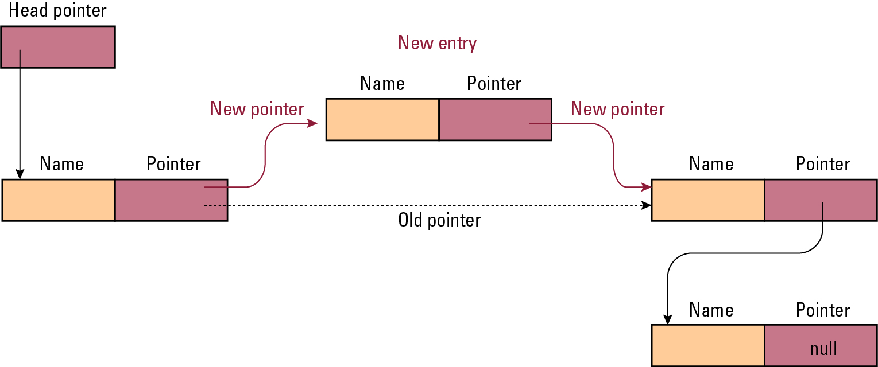
Inserting an Entry Into a Linked List
2014/8/29
18
Notes:
如果我們要在一個指定的entry插入一個entry，則該指定的entry則要指向新的entry，新的entry則要指向原本指定的entry所指向的entry
一樣的例子，以皇位繼承人來舉例，把List看成繼承順序，皇帝(Head pointer)規定太子為第一順位，而二阿哥排在太子後面，但今天三阿哥出生了，皇帝比較喜歡生三阿哥的嬪妃，所以決定把三阿哥放到第二繼承順位，則就會變成太子要指向三阿哥，三阿哥在指向二阿哥了
54

Slide 26
Storing Stacks and Queues
Stacks usually stored as contiguous lists.
Queues usually stored as Circular Queues
Stored in a contiguous block in which the first entry is considered to follow the last entry.
Prevents a queue from crawling out of its allotted storage space.
2014/8/29
18
Notes:
堆疊通常會用用陣列實作的list來儲存
queue通常會被儲存成循環的queue
-存在一個連續的區塊中期第一個entry要跟隨最後一個entry(?? 每個區塊並不是連續的記憶體，但透過point有了連接的連續關係?)
-避免在讀取queue的時候 超出所配置的儲存空間
54

Slide 27
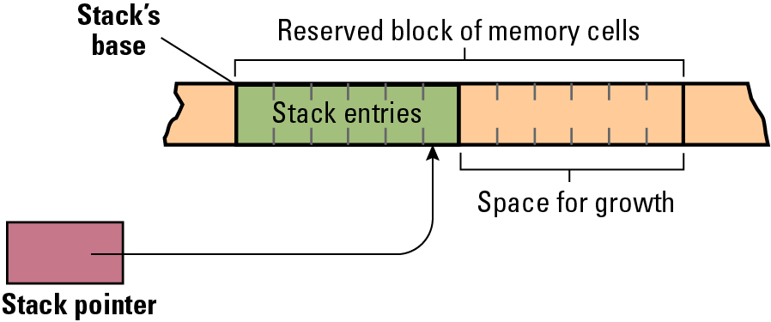
A Stack in Memory
2014/8/29
18
Notes:
Stack在memory是怎麼儲存的
會先要一個大空間，放資料會一直往右邊放，但要取資料也會先從右邊取
Stack’sbase 是基底
54

Slide 28
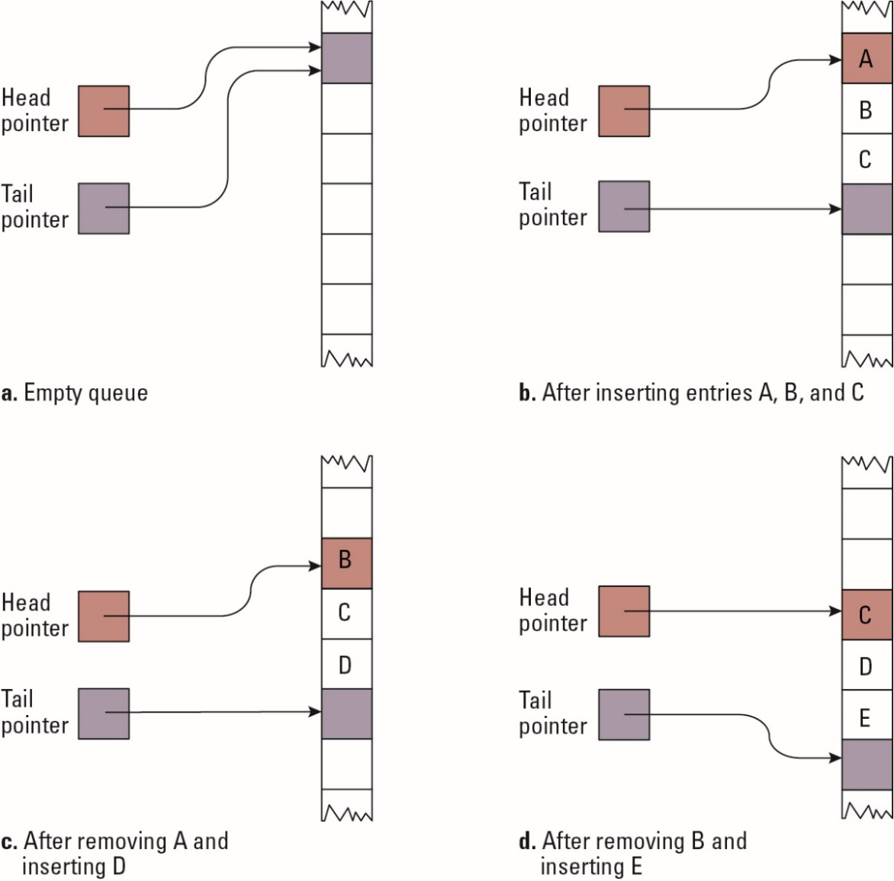
A Queue Implementation with Head and Tail Pointers
2014/8/29
18
Notes:
Queue 如何實作
54

Slide 29
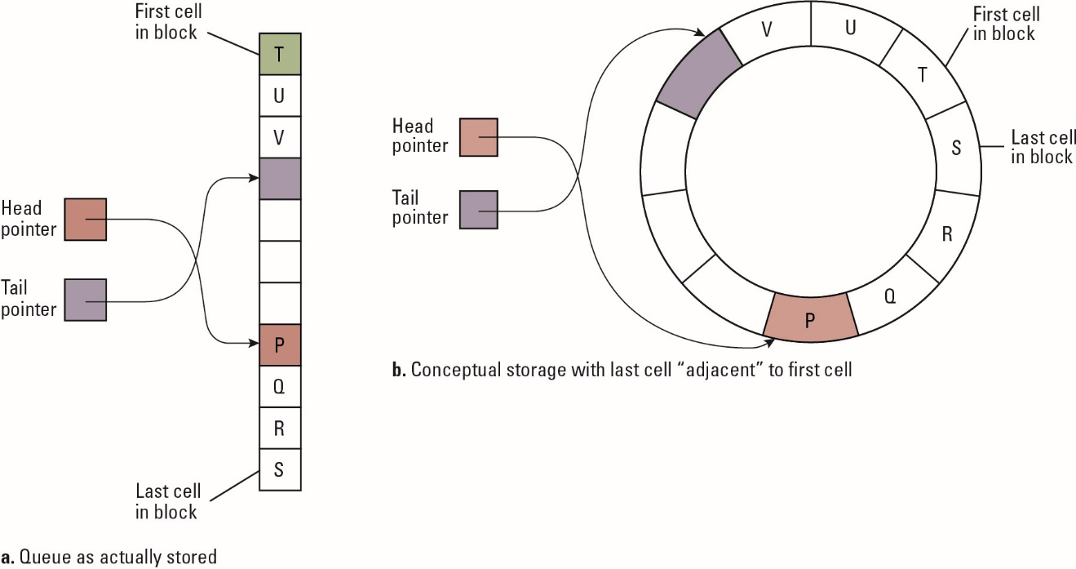
A Circular Queue Containing the Letters P Through V
2014/8/29
18
Notes:
循環queue如何實作
54

Slide 30
Storing Binary Trees
Linked structure.
Each node = data cells + two child pointers.
Accessed via a pointer to root node.
Contiguous array structure.
A[1] = root node.
A[2],A[3] = children of A[1].
A[4],A[5] = children of A[2] .
A[6],A[7] = children of A[3] .
2014/8/29
18
Notes:
連結結構
-每一個節點=資料cell + 兩個指向子節點的指標
-要訪問一個節點必須從root節點一路指過去
用陣列來實作Binary Tree的結構
畫圖會比較好理解(P36有圖)
54

Slide 31
The Structure of a Node in a Binary Tree
2014/8/29
18
Notes:
Binary Tree的結構
Cell 存放著資料(value)以及指向左子的指標，右子的指標
54

Slide 32
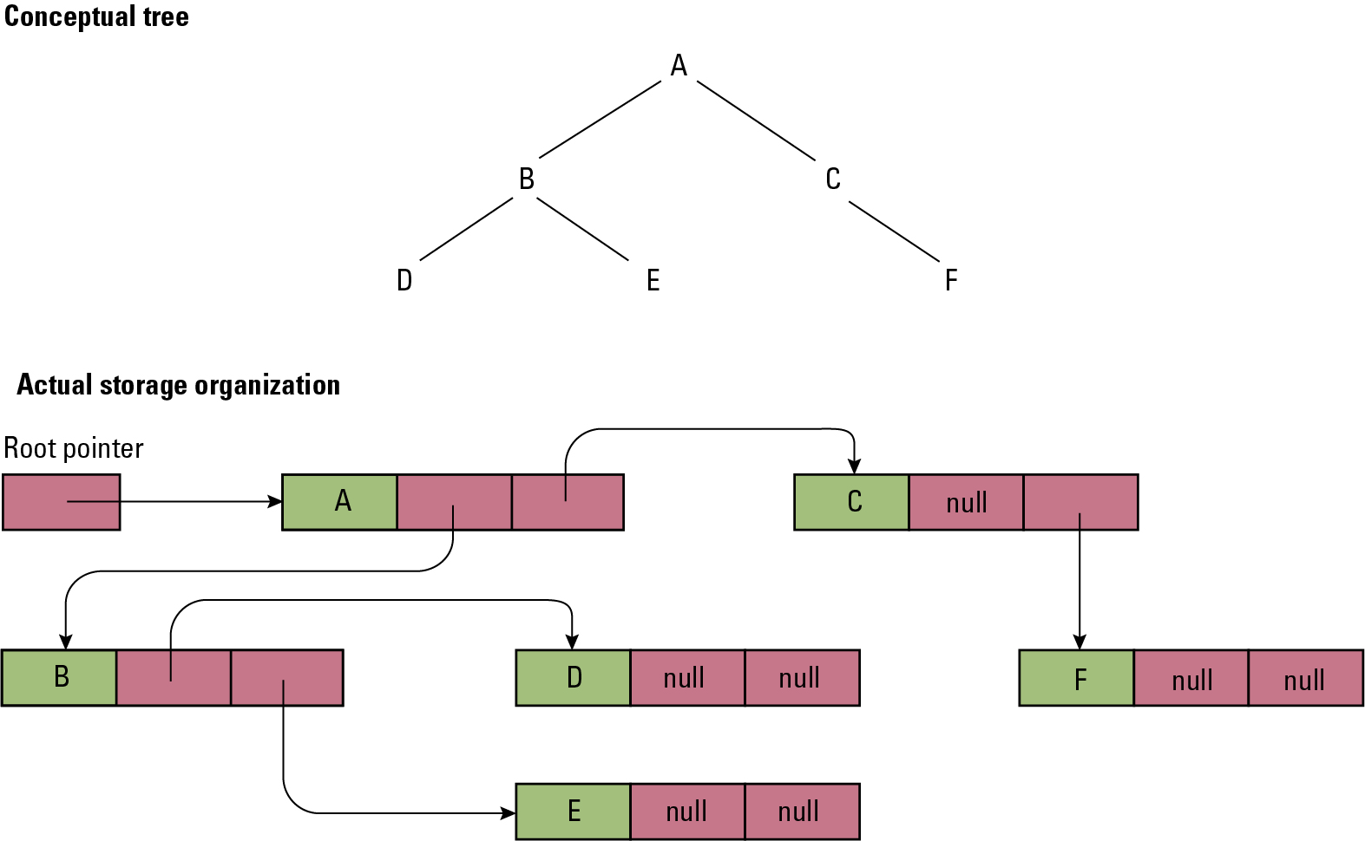
The Conceptual and Actual Organization of a Binary Tree Using a Linked Storage System
2014/8/29
32
Notes:
對於沒有左右子的部分，存放null避免超出配置的空間
54

Slide 33
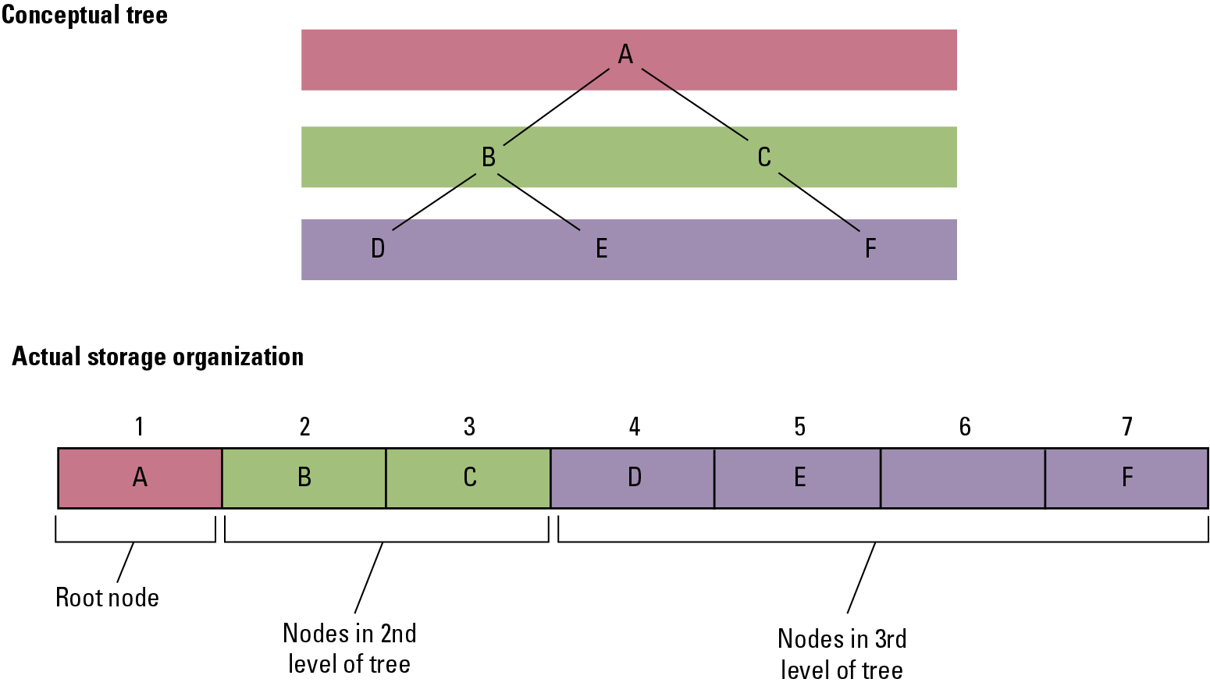
A Tree Stored Without Pointers
2014/8/29
32
Notes:
54

Slide 34
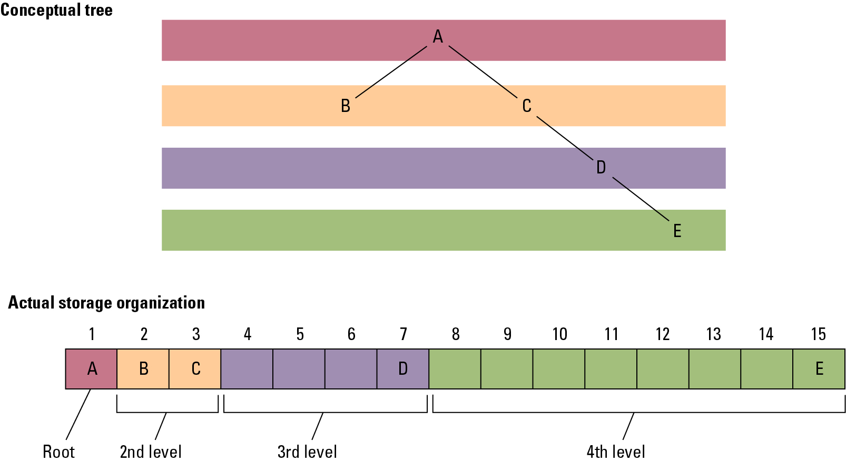
A Sparse, Unbalanced Tree Shown in its Conceptual Form and as it Would be Stored Without Pointers
2014/8/29
34

Slide 35
Manipulating Data Structures
Ideally, a data structure should be manipulated solely by pre-defined functions.
Example: A list typically has a function insert for inserting new entries.
The data structure along with these functions constitutes a complete abstract tool.
2014/8/29
34
Notes:
理想狀況下，資料結構應該透過預定異好的函數來實作
-例子:list通成會有個function名為insert來插入資料
-資料結構跟這些功能構成了一個完整的抽象工具(?)
54

Slide 36
A Function for Printing a Linked List
def PrintList (List):
CurrentPointer = List.Head
while (CurrentPointer is not None):
print(CurrentPointer.Value)
CurrentPointer = CurrentPointer.Next
2014/8/29
36
Notes:
這個函式從head一直找下一個point到結尾為止
54

Slide 37
Case Study
Problem:
Construct an abstract tool consisting of a list of names in alphabetical order along with the operations: search, print, and insert.
2014/8/29
36
Notes:
建造一個抽象工具，這個工具必須按照字母順序排列它的名稱list，並且有搜尋，印出跟插入的功能
54

Slide 38
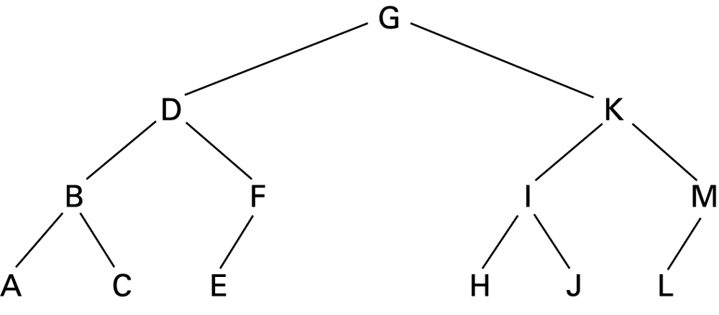
The Letters A Through M Arranged in an Ordered Tree
2014/8/29
36
Notes:
用二元樹來排序字母
樹不一定是這個結構
54

Slide 39
The Binary Search as it Would Appear if the List were Implemented as a Linked Binary Tree
def Search (Tree, TargetValue):
if (Tree is None):
return None # Search failed
elif (TargetValue == Tree.Value):
return Tree # Search succeeded
elif (TargetValue < Tree.Value):
# Continue search in left subtree
return Search(Tree.Left, TargetValue)
elif (TargetValue > Tree.Value):
# Continue search in right subtree
return Search(Tree.Right, TargetValue)
2014/8/29
39
Notes:
如何在二元樹搜尋指定的值
54

Slide 40
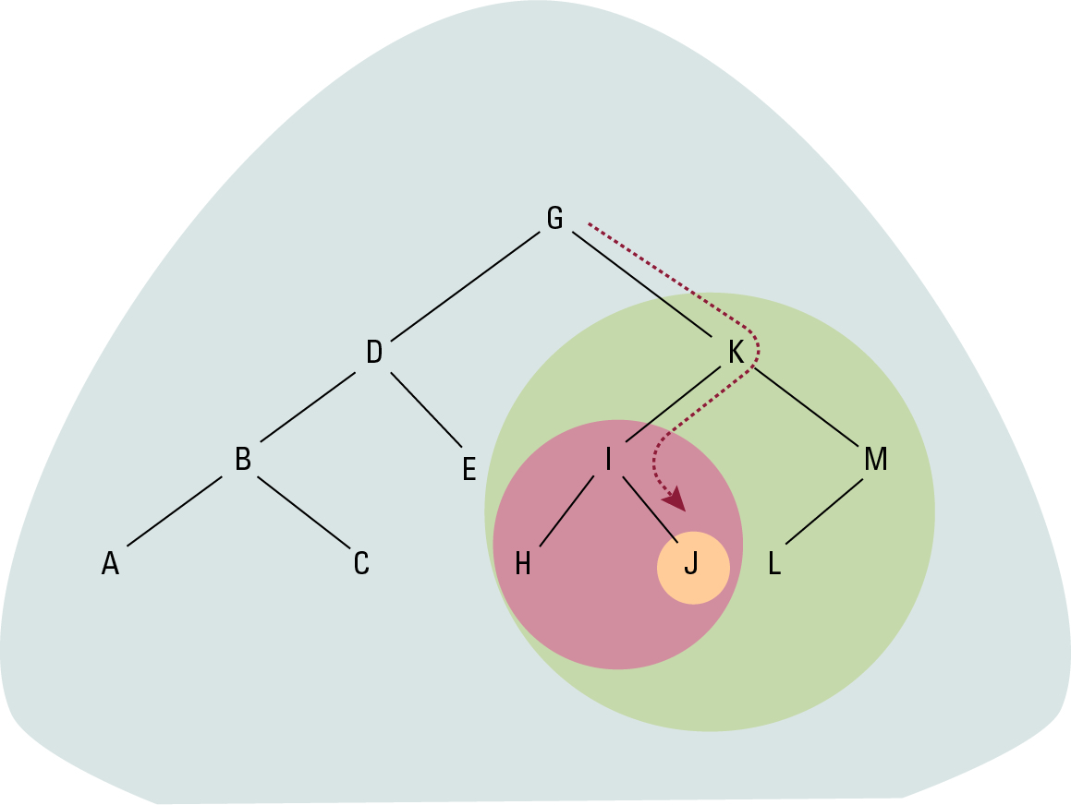
The Successively Smaller Trees Considered by the Function when Searching for the Letter J
2014/8/29
40
Notes:
用圖來表明二元樹如何搜尋
54

Slide 41
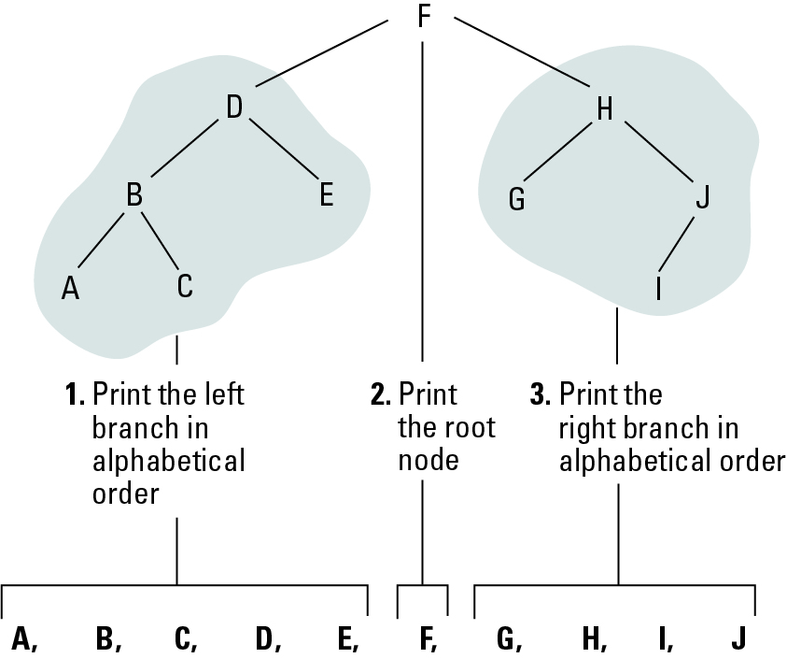
Printing a Search Tree in Alphabetical Order
2014/8/29
40
Notes:
按照字母順序來印出
54

Slide 42
A Function for Printing the Data in a Binary Tree
def PrintTree (Tree):
if (Tree is not None):
PrintTree(Tree.Left)
print(Tree.Value)
PrintTree(Tree.Right)
2014/8/29
42
Notes:
54

Slide 43
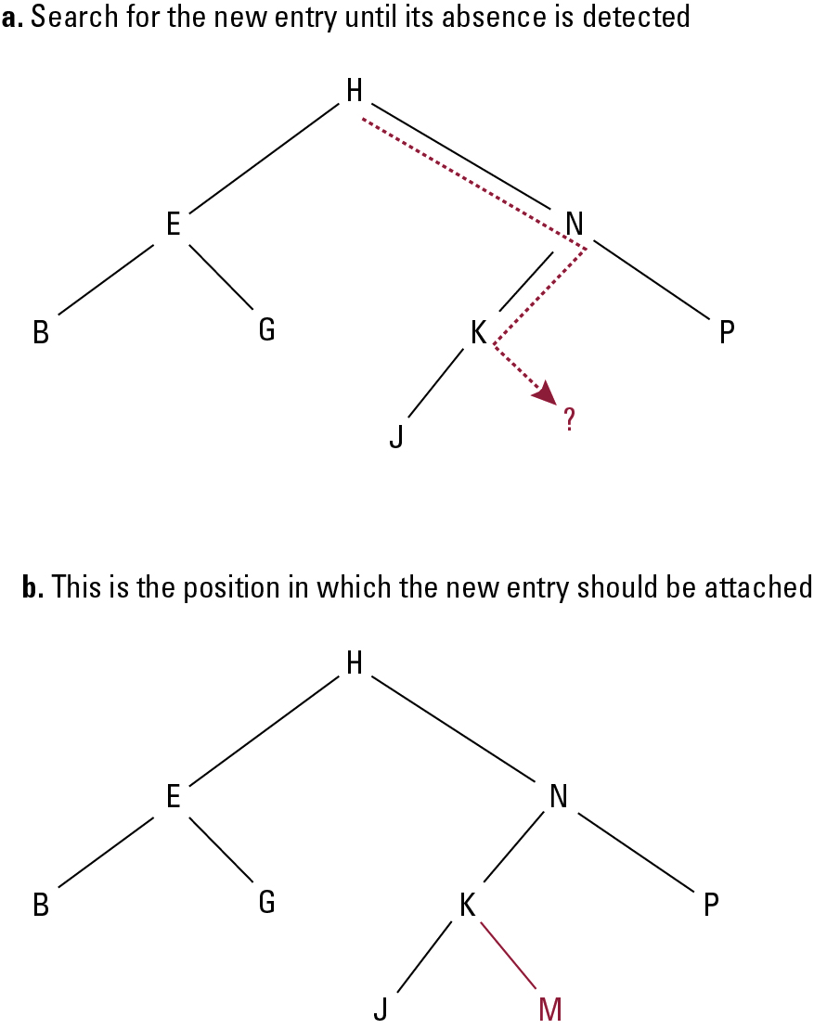
Inserting the Entry M into the List B, E, G, H, J, K, N, P Stored as a Tree
2014/8/29
43
Notes:
如何插入一個新的M
a.找尋一個新的entry直到偵測的空缺
b.這個空缺的位置就是M要被擺進去的位置
54

Slide 44
A Function for Inserting a New Entry in a List Stored as a Binary Tree
def Insert(Tree, NewValue):
if (Tree is None):
# Create a new leaf with NewValue
Tree = TreeNode()
Tree.Value = NewValue
elif (NewValue < Tree.Value):
# Insert NewValue into the left subtree
Tree.Left = Insert(Tree.Left, NewValue)
elif (NewValue > Tree.Value):
# Insert NewValue into the right subtree
Tree.Right = Insert(Tree.Right, NewValue)
else:
# Make no change
return Tree
2014/8/29
44
Notes:
如何去insert
54

Slide 45
Heap
A complete binary tree structure
Each child nodes are larger/smaller than their parent
Min - heap
Parent < Child
Max - heap
Parent > Child
2014/8/29
44
Notes:
54

Slide 46
Heap Insertion
Append the target value to the end of a Heap
Compare the value with parent node’s value
If the target value is greater or smaller (max/min heap) than parent node’s value, swap the target node and parent node
Repeat
2014/8/29
44
Notes:
54

Slide 47
Heap Deletion
Replace the target value with a max/min value
Swap the max/min value and the parent node until root node
Swap the root and the last node
Delete the last node
Heapify
2014/8/29
44
Notes:
54

Slide 48
User-defined Data Type
Use an aggregate structure to define new type, in C:
struct EmployeeType
{
char Name[25];
int Age;
float SkillRating;
}
Use the new type to define variables:
struct EmployeeType DistManager, SalesRep1;
2014/8/29
44
Notes:
如何去宣告
54

Slide 49
Abstract Data Type
A user-defined data type that can include both data (representation) and functions (behavior).
Example:
interface StackType
{
public int pop();
public int push(int item);
public boolean isEmpty();
public boolean isFull();
}
2014/8/29
44
Notes:
自定義的資料結構可以包括資料跟狀態
54

Slide 50
Class
An abstract data type with extra features.
Properties can be inherited.
Constructor methods to initialize new objects.
Contents can be encapsulated.
2014/8/29
44
Notes:
具有額外功能的抽象的資料類型(有metho的struct)
可以被繼承屬性
Constructor methods是用來被初始化物件的
內容可以封裝(我們可以透過private來宣告屬性或function使得要從外部操控只能透過public的函式)
(EX:就像一間餐廳，服務員對廚師說客人點什麼菜(public function)，但服務員並不能干涉廚師怎麼做菜(private function)或做菜單上沒有的菜(public function沒有的部分))
54

Slide 51
A Stack of Integers Implemented in Java and C#
class StackOfIntegers implements StackType
{
private int[] StackEntries = new int[20];
private int StackPointer = 0;
public void push(int NewEntry)
{ if (StackPointer < 20)
StackEntries[StackPointer++] = NewEntry;
}
public int pop()
{ if (StackPointer > 0) return StackEntries[--StackPointer];
else return 0;
}
public boolean isEmpty()
{ return (StackPointer == 0);
}
public boolean isFull()
{ return (StackPointer >= MAX);
}
}
2014/8/29
44
Notes:
在C#和java實作
54

Slide 52
Pointers in Machine Language
Immediate addressing: Instruction contains the data to be accessed.
Direct addressing: Instruction contains the address of the data to be accessed.
Indirect addressing: Instruction contains the location of the address of the data to be accessed.
2014/8/29
44
Notes:
在機器語言中的指標
Immediate addressing:指令中包含要的資料 ex. ADD 5
Direct addressing:指令中包含要被訪問的資料的位址(ex:0Xa5),這個位址的值指向資料
Indirect addressing: 指令中包含要被訪問的資料所在的地點(Register),這個地點內的值指向資料
指令 (IR)
54

Slide 53
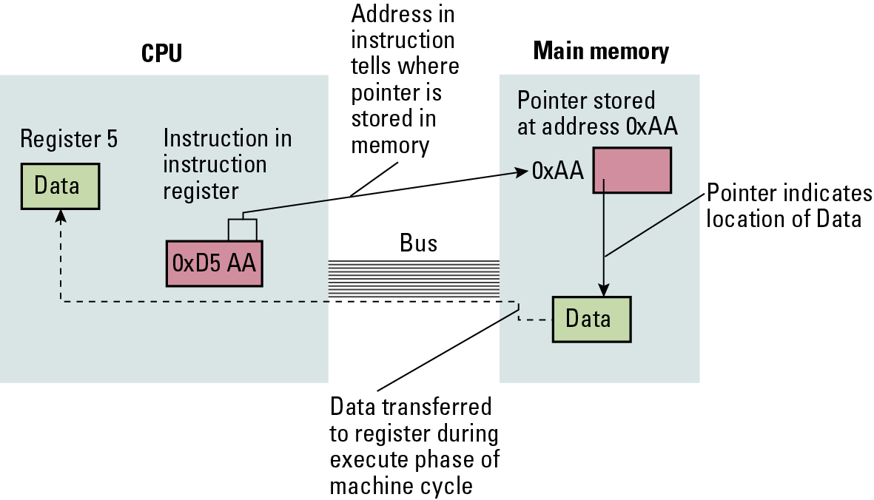
Our First Attempt at Expanding the Machine Language in Appendix C to Take Advantage of Pointers
2014/8/29
53
Notes:
指令內包一個位址A，這個位址A內的值也是一個位址，稱他為位址B，位址B裡面存著我們要存取的資料
<number>

Slide 54
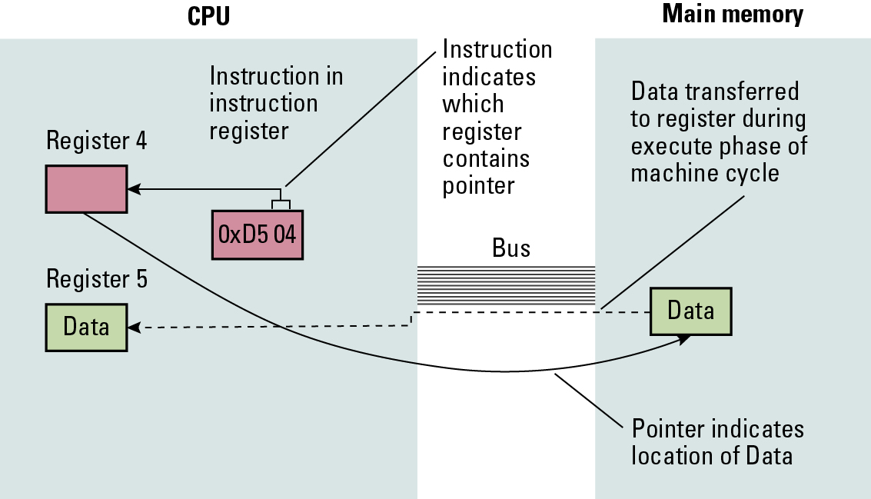
Loading a Register from a Memory Cell that is Located by Means of a Pointer Stored in a Register
2014/8/29
54
Notes:
指令裡面包含了一個暫存器，這個暫存器裡面存了一個位址(暫存器的值)，這個位址所存放的值是我們要存取的資料
<number>

Slide 55
Graphs
2014/8/29
54
Notes:
<number>

