Slide 1

Introduction to Computer Science
William Hsu
Advanced Computation Laboratory
Department of Computer Science and Engineering
Department of Environmental Biology and Fisheries Science
National Taiwan Ocean University

Slide 2
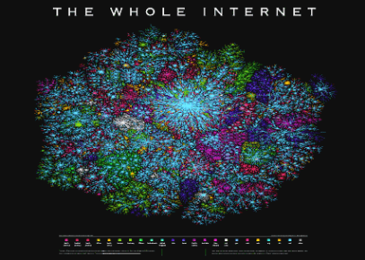

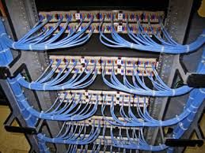

Chapter 4: Networking and the Internet
No one owns the Internet, and only one organization controls the Internet in its entirety. More of a concept than an actual tangible entity, the Internet relies on a physical infrastructure that connects networks to other networks. There are, however, organizations that oversee and standardize what happens on the Internet and assign IP addresses and domain names, such as the National Science Foundation, the Internet Engineering Task Force, ICANN, InterNIC and the Internet Architecture Board.

Slide 3

4.1 Network Fundamentals
4.2 The Internet
4.3 The World Wide Web
4.4 Internet Protocols
4.5 Security

Slide 4
Network Classifications
Scope
Personal Area Network (PAN)
Local Area Network (LAN)
Campus Area Network (CAN)
Metropolitan Area Network (MAN)
Wide Area Network (WAN)
Storage-Area Network (SAN)
Virtual Private Network (VPN)
Client Server Network
Peer to Peer Network (P2P)
Ownership
Closed versus open
Topology (configuration)
Bus (Ethernet)
Star (Wireless networks with central Access Point)
Ring
Tree (Hierarchical)
Mesh

Slide 5
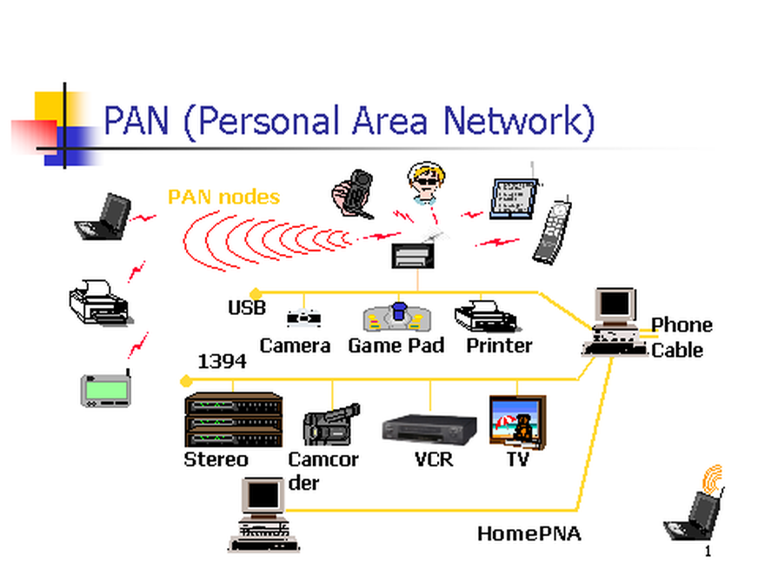
Personal Area Network
Personal Area Network (PAN) is a computer network used for data transmission amongst devices such as computers, telephones, tablets and personal digital assistants.
Also Known as HAN (Home Area Network)
PANs can be used for communication amongst the personal devices themselves (interpersonal communication), or for connecting to a higher level network and the Internet (an uplink) where one "master" device takes up the role as internet router.

Slide 6
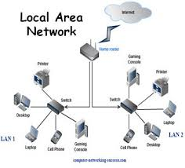
Local Area Network
Xerox Corporation worked in collaboration with DEC and Intel to create Ethernet, which is the most pervasive LAN architecture used today.
Ethernet has evolved and has seen significant improvements in regard to speed and efficiency.
An upside of a LAN is fast data transfer with data speed that can reach up to 10Gbps.
Other significant LAN technologies are Fiber Distributed Data Interface (FDDI) and token ring.

Slide 7
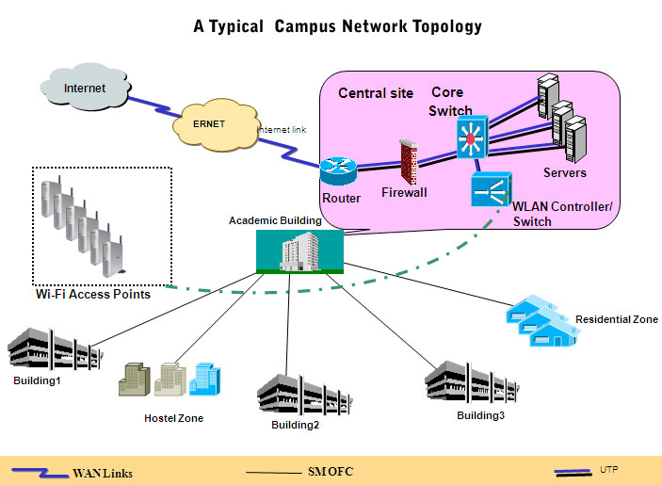
Campus Area Network
Larger than LANs, but smaller than metropolitan area networks these types of networks are typically seen in universities, large K-12 school districts or small businesses.
They can be spread across several buildings that are fairly close to each other so users can share resources

Slide 8
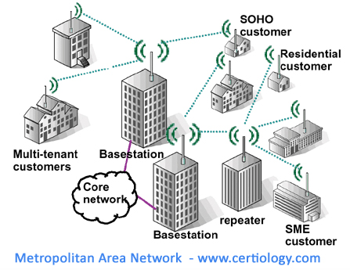
Metropolitan Area Network
A MAN is larger than a LAN but smaller than or equal in size to a WAN.
The size range anywhere from 5 to 50km in diameter.
MANs are typically owned and managed by a single entity.
This could be an ISP or telecommunications company that sells its services to end-users in that metropolitan area.
For all intents and purposes, a MAN has the same characteristics as a WAN with distance constraints.

Slide 9

Wide Area Network
A Wide Area Network exist over a large area
Data travels through telephone or cable lines
Usually requires a Modem
The world’s largest Wide Area Network in the Internet

Slide 10
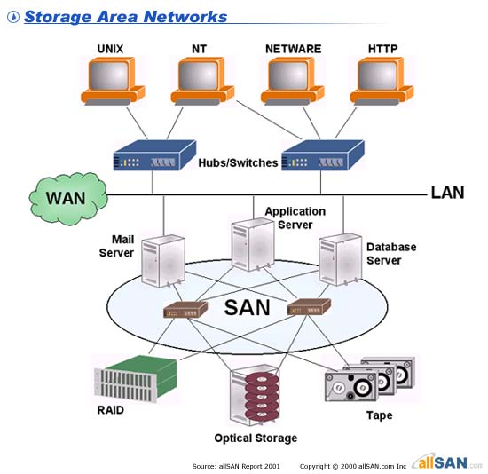
Storage Area Network
SAN may be referred to as a Sub network or special purpose network.
Its special purpose is to allow users on a larger network to connect various data storage devices with clusters of data servers.
SANs can be accessed in the same fashion as a drive attached to a server.

Slide 11
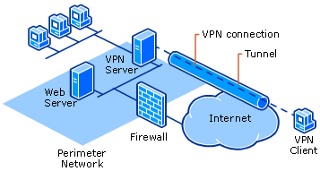
Virtual Private Network
VPN is a private network that can access public networks remotely. VPN uses encryption and security protocols to retain privacy while it accesses outside resources.
When employed on a network, VPN enables an end user to create a virtual tunnel to a remote location. Typically, telecommuters use VPN to log in to their company networks from home.
Authentication is provided to validate the identities of the two peers.
Confidentiality provides encryption of the data to keep it private from prying eyes.
Integrity is used to ensure that the data sent between the two devices or sites has not been tampered with.

Slide 12
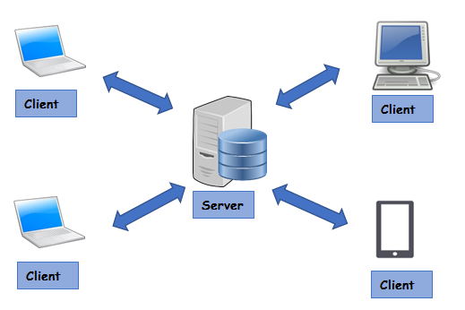
Client/Server Network
In a client/server arrangement, network services are located on a dedicated computer called a server.
The server responds to the requests of clients.
The server is a central computer that is continuously available to respond to requests from clients for file, print, application, and other services.
Most network operating systems adopt the form of a client/server relationship.
Typically, desktop computers function as clients, and one or more computers with additional processing power, memory, and specialized software function as servers.

Slide 13
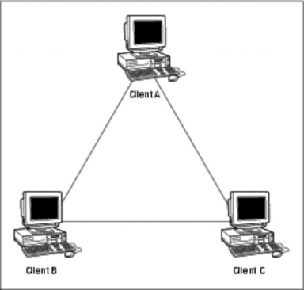
Peer to Peer Network
Usually very small networks
Each workstation has equivalent capabilities and responsibilities
Does not require a switch or a hub.
These types of networks do not perform well under heavy data loads.

Slide 14
Network Topologies
Network topology defines the structure of the network.
Physical topology:- It define the actual layout of the wire or media.
Bus
Ring
Star
Tree(Hierarchical)
Mesh
Logical topology:- It defines how the hosts access the media to send data.
Broadcast
Token passing
Hybrid Topology

Slide 15
Bus Topology
All devices are connected to a central cable, called bus or backbone.
There are terminators at each end of the bus that stops the signal and keeps it from traveling backwards.
T
T

Slide 16
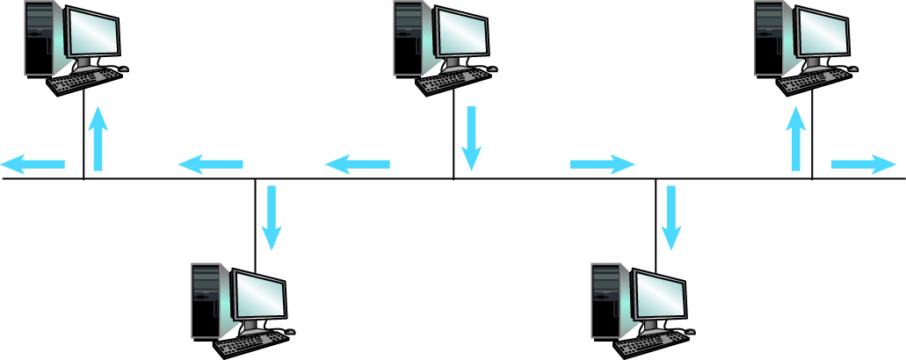
Communication Over a Bus Network

Slide 17
Bus Topology
Advantages:
There is no central controller.
Control resides in each station
The less interconnecting wire is required.
Ease of installation.
Backbone cable can be laid along the most efficient path, and then connected to the nodes by drop lines of various lengths
Disadvantages:
It is possible that more than one station may attempt transmission simultaneously (collision or contention).
Difficult reconfiguration and fault isolation.
A fault or break in the bus cable stops all transmission, even between devices on the same side of the problem.
The damaged area reflects signals in the direction of origin, creating noise in both directions

Slide 18
Ring Topology
All devices are connected to one another in the shape of a closed loop.
Each device is connected directly to two other devices, one on either side of it.
Advantages:
Avoids the collisions that are possible in the bus topology.
Each pair of stations has a point-to-point connection.
A signal is passed along the ring in one direction, from device to another, until it reaches its destination.
Each device incorporates a repeater.
Relatively easy to install and reconfigure.
Fault isolation is simplified.
Disadvantages:
A break in the ring (such as station disabled) can disable the entire network.
Unidirectional traffic.

Slide 19
Star Topology
All devices are connected to a central hub.
Nodes communicate across the network by passing data through the hub or switch.
Advantages:
Easy to install and reconfigure.
Robustness, if one link fails; only that link is affected. All other links remain active.
Easy fault identification and isolation. As long as the hub is working, it can be used to monitor link problems and bypass defective links.
Disadvantages:
The devices are not linked to each other.
If one device wants to send data to another, it sends it to the controller, which then relays the data to the other connected device.

Slide 20
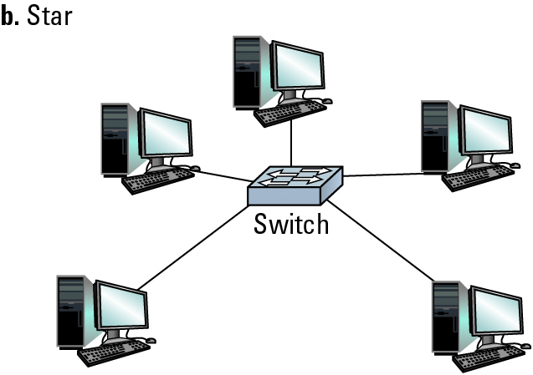
Network Topologies (continued)

Slide 21
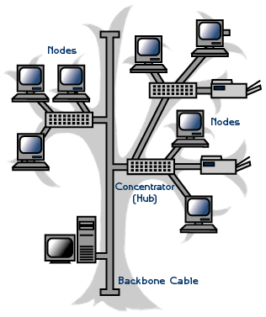
Tree/Hierarchical Topology
Advantages:
It allows more devices to be attached to a single central hub and can therefore increase the distance a signal can travel between devices.
It allows the network to isolate and prioritize communications from different computers.
Disadvantages:
The devices are not linked to each other.
If one device wants to send data to another, it sends it to the controller, which then relays the data to the other connected device.
The addition of secondary hubs brings two further advantages.

Slide 22
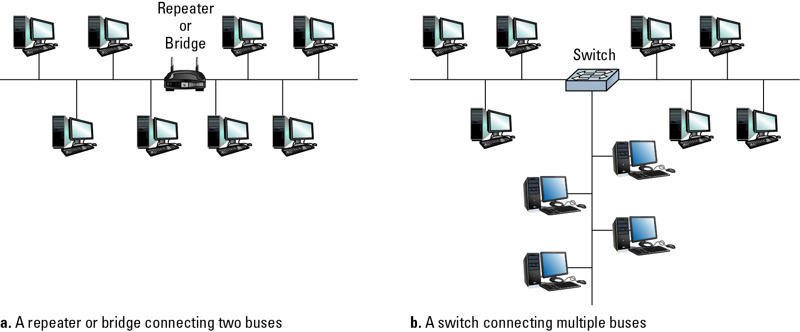
Building a Large Bus Network from Smaller Ones

Slide 23
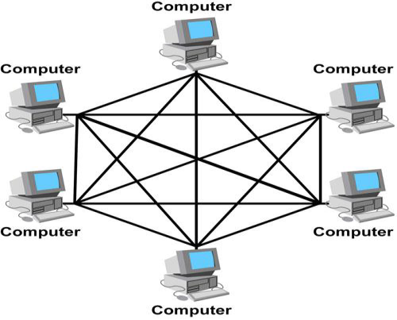
Mesh Topology
Each host has its connections to all other hosts.
Mesh topology is implemented to provide as much protection as possible from interruption of service.
A nuclear power plant might use a mesh topology in the networked control systems.
Although the Internet has multiple paths to any one location, it does not adopt the full mesh topology.

Slide 24
Mesh Topology
Advantages:
The use of dedicated links guarantees that each connection can carry its data load, thus eliminating the traffic problems that can occur when links must be shared by multiple devices.
It is robust, if one link becomes unusable, it does not incapacitate (affect) the entire system.
Privacy and Security (every message sent travels along a dedicated line; only the intended recipient sees it).
Point-to-point links make fault identification and fault isolation easy.
Disadvantages:
A large amount of cabling required.
A large amount of I/O ports required.
Installation and reconfiguration are difficult.
The sheer bulk of the wiring can be greater than the available space (in the walls, ceiling, or floors) can accommodate.
The hardware required to connect each link (I/O ports and cables) can be prohibitively expensive.

Slide 25
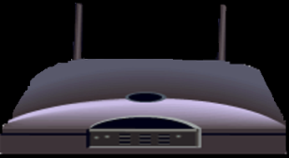
Wireless Networks
Wireless network is a type of computer network that uses wireless data connections for connecting network nodes.
Example
Bluetooth
Wi-Fi
3G/4G

Slide 26

Bluetooth
Bluetooth is a short-range wireless technology standard used for exchanging data between fixed and mobile devices over short distances.
It is using UHF radio waves in the ISM bands, from 2.402 GHz to 2.48 GHz.
The IEEE standardized Bluetooth as IEEE 802.15.1, but no longer maintains the standard.

Slide 27
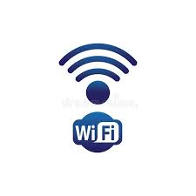
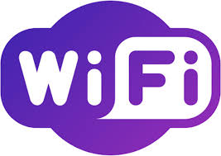
Wi-Fi
Wi-Fi Stands for Wireless Fidelity.
Wi-Fi, is a Local Area Wireless technology.
Wi-Fi networks use radio technologies to transmit and receive data at high speed.
It is based on the IEEE 802.11 family of standards.
Access point: The access point is a wireless LAN transceiver or “ base station” that can connect one or many wireless devices simultaneously to the internet

Slide 28
Protocols
Rules by which activities are conducted on a network
Example: Coordinating the transmission of messages between computers
Need to avoid all machines transmitting at the same time
Allows vendors to build products that are compatible with products from other vendors

Slide 29
Protocols
CSMA/CD
Used in Ethernet
Silent bus provides right to introduce new message
Both machines stop and wait for a independent, random time
CSMA/CA
Used in WiFi
Hidden terminal problem
Give advantage to the machine that has already been waiting

Slide 30
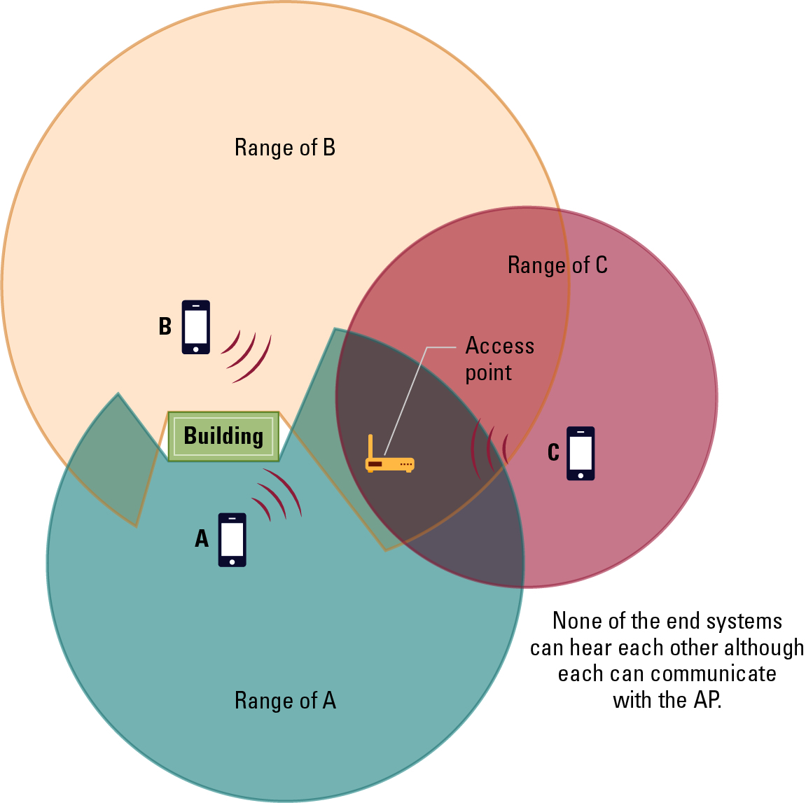
The Hidden Terminal Problem

Slide 31
Connecting Networks
Repeater: Extends a network.
POE: Power over Ethernet.
Bridge: Connects two compatible networks.
Bridges forward packets without analyzing and rerouting messages.
Switch: Connects several compatible networks.
Hubs.
Router: Connects two incompatible networks resulting in a network of networks called an internet.
Power consumption and capability:
Hubs < Bridges < Switches < Routers

Slide 32
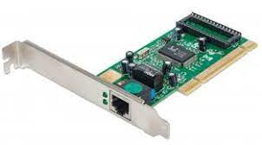
Network Interface Card
NIC is used to physically connect host devices to the network media.
A NIC is a printed circuit board that fits into the expansion slot of a bus on a computer motherboard.
NICs are sometimes called network adapters.
Each NIC is identified by a unique code called a Media Access Control (MAC) address.
This address is used to control data communication for the host on the network.

Slide 33
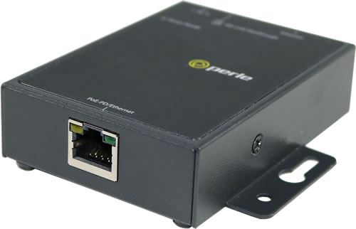
Repeaters
A repeater is a network device used to regenerate a signal.
Repeaters regenerate analog or digital signals that are distorted by transmission loss due to attenuation.
A repeater does not make an intelligent decision concerning forwarding packets.

Slide 34
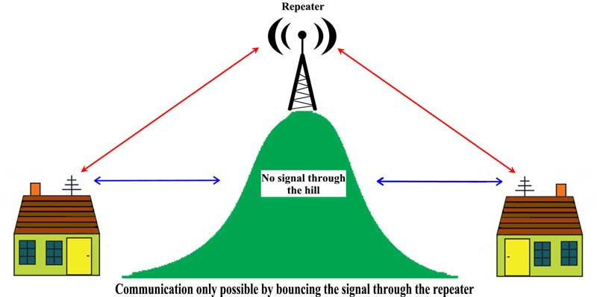
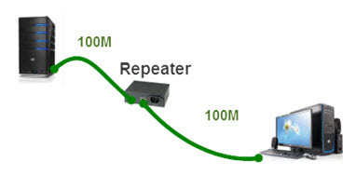
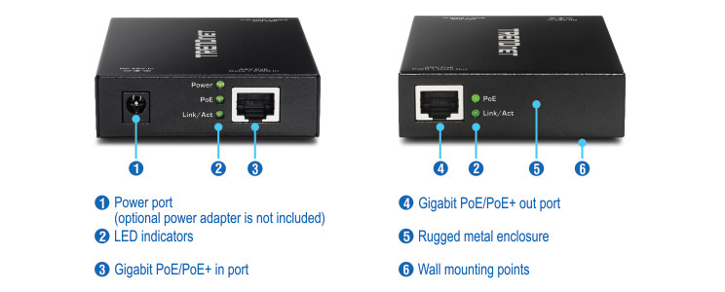
Repeaters

Slide 35
Hubs
A hub interconnects two or more workstations into a local area network.
Allow the network to see them as a single unit.
When a workstation transmits to a hub, the hub immediately resends the data frame to all connecting links.
Active hubs concentrate hosts and also regenerate signals.
Hubs expand one Ethernet connection into many.
For example, a four-port hub connects up to four machines.

Slide 36
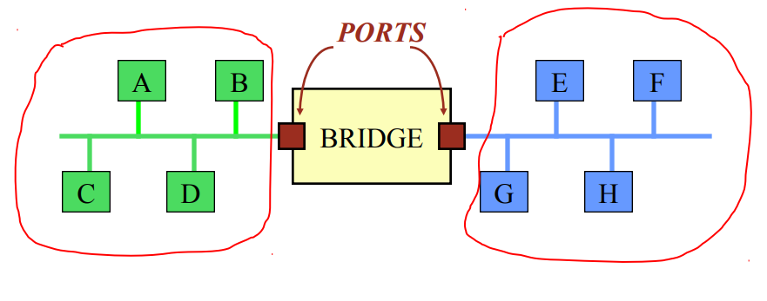
Bridge
A bridge connects networks and forwards frames from one network to another.
If A sends a frame to E - the frame must be forwarded by the bridge.
If A sends a frame to B - there is no reason to forward the frame.

Slide 37
Bridges
Bridges convert network data formats and perform basic data transmission management.
Bridges provide connections between LANs.
They also check data to determine if it should cross the bridge. This makes each part of the network more efficient

Slide 38
Switches
A switch is a combination of a hub and a bridge.
It can interconnect two or more workstations, but like a bridge, it observes traffic flow and learns.
When a frame arrives at a switch, the switch examines the destination address and forwards the frame out the one necessary connection.
The backplane of a switch is fast enough to support multiple data transfers at one time.
Multiple workstations connected to a switch use dedicated segments.
This is a very efficient way to isolate heavy users from the network.

Slide 39
Routers
Routers have all the capabilities listed above.
Routers can regenerate signals, concentrate multiple connections, convert data transmission formats, and manage data transfers.
They can also connect to a WAN, which allows them to connect LANs that are separated by great distances.

Slide 40
Routers
Specialized computers.
The device that connects a LAN to a WAN or a WAN to a WAN (the INTERNET! – uses IP addresses).
A router accepts an outgoing packet, removes any LAN headers and trailers, and encapsulates the necessary WAN headers and trailers.
Because a router has to make wide area network routing decisions, the router has to dig down into the network layer of the packet to retrieve the network destination address.
Thus, routers are often called “layer 3 devices”.
They operate at the third layer, or OSI network layer, of the packet.

Slide 41
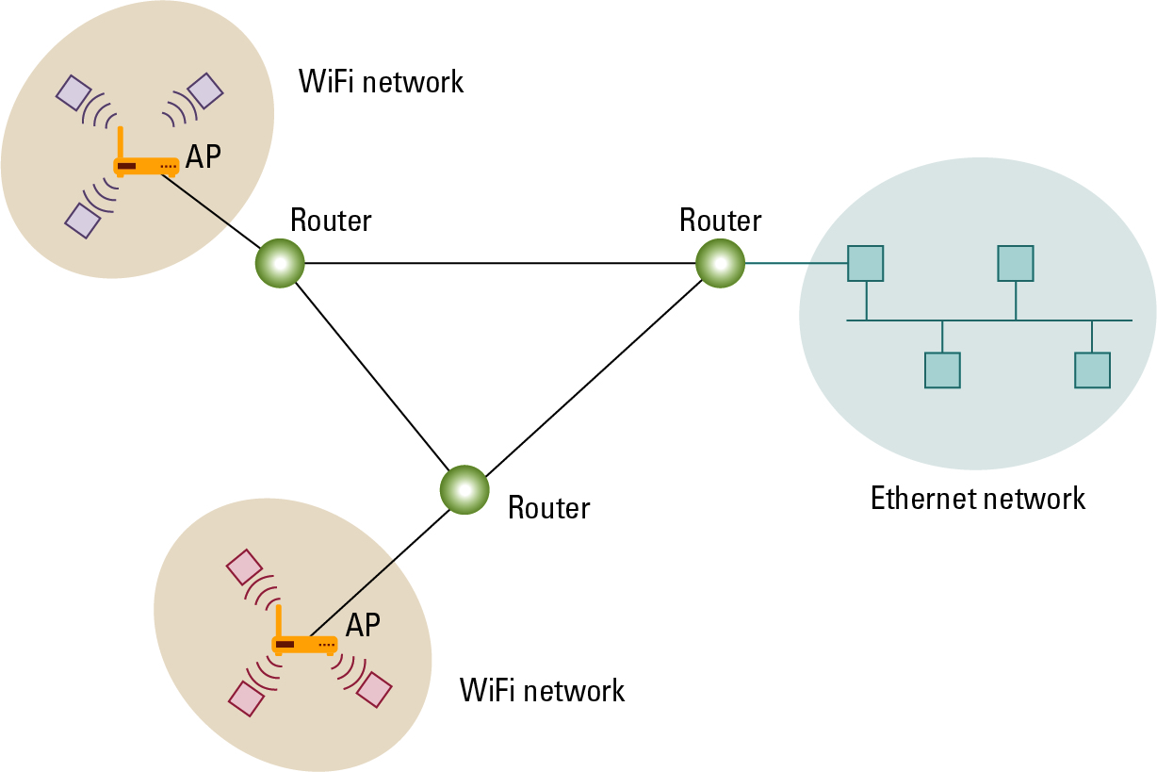
Routers Connecting Two WiFi Networks and an Ethernet Network to Form an Internet

Slide 42
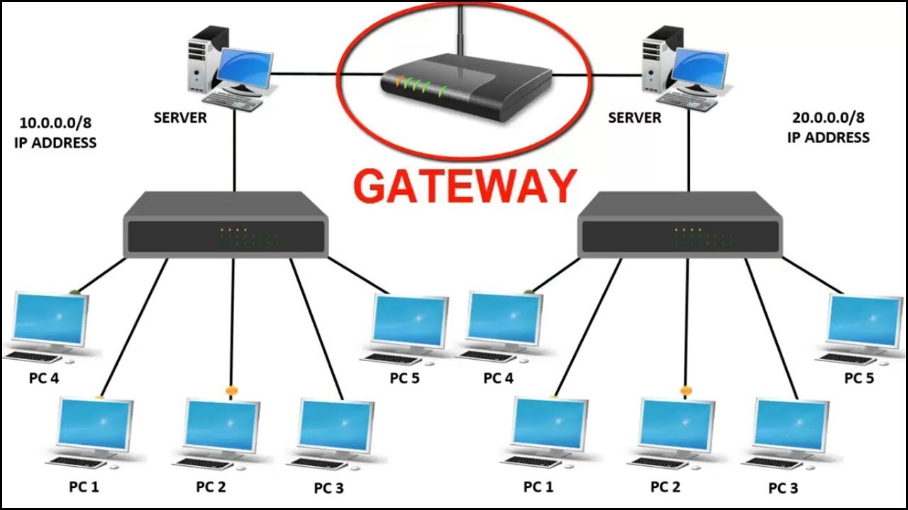
Gateway
A gateway is a piece of networking hardware used in telecommunications for telecommunications networks that allows data to flow from one discrete network to another.
Gateways are distinct from routers or switches in that they communicate using more than one protocol to connect a bunch of networks

Slide 43
Firewall
A firewall is a network device or software for controlling network security and access rules.
Firewalls are inserted in connections between secure internal networks and potentially insecure external networks such as the Internet.
Firewalls are typically configured to reject access requests from unrecognized sources while allowing actions from recognized ones.
The vital role firewalls play in network security grows in parallel with the constant increase in cyber attacks.

Slide 44
Network Media
The function of the media is to carry a flow of information through a LAN.
Wired Media:- A widely adopted family that uses copper and fiber media in local area network (LAN) technology are collectively known as Ethernet
Copper Cable
Coaxial Cables
Shielded Twisted Pair(STP)
Unshielded Twisted Pair
Fibre Optic Cable
Wireless Media:- use the atmosphere, or space, as the medium.

Slide 45
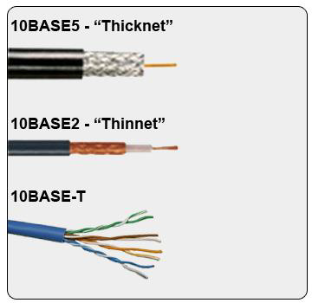
Copper Cable
The most common, easiest, quickest, and cheapest form of network media to install.
The disadvantage of sending data over copper wire is that the further the signal travels, the weaker it becomes.

Slide 46
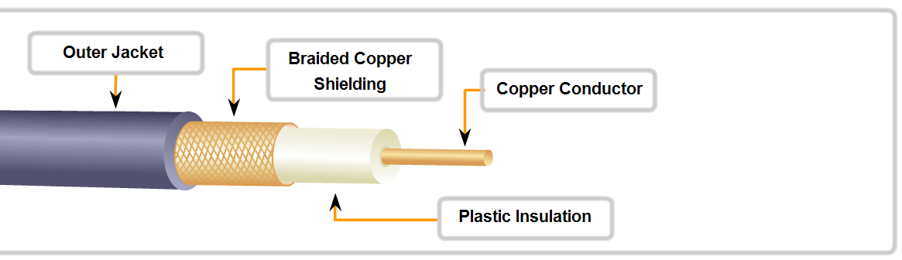
Coaxial Cable
It can be run longer distances than Twisted pair Cables.
Speed: 10-100Mbps
Cost: Inexpensive
Media and connector size: Medium
Maximum cable length: 500m

Slide 47
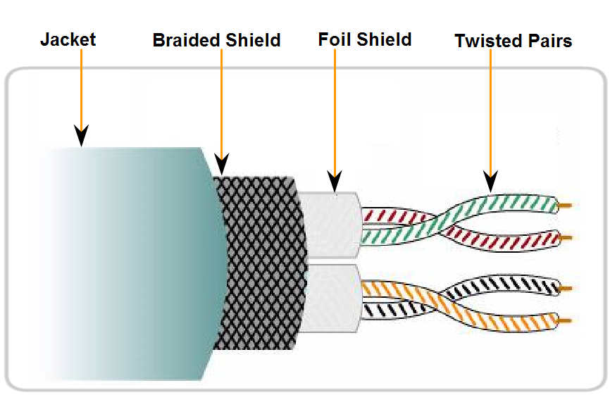
Shielded Twisted Pair(STP)
Speed: 0-100Mbps
Cost: Moderate
Media and connector size: Medium to large
Maximum cable length: 100m

Slide 48
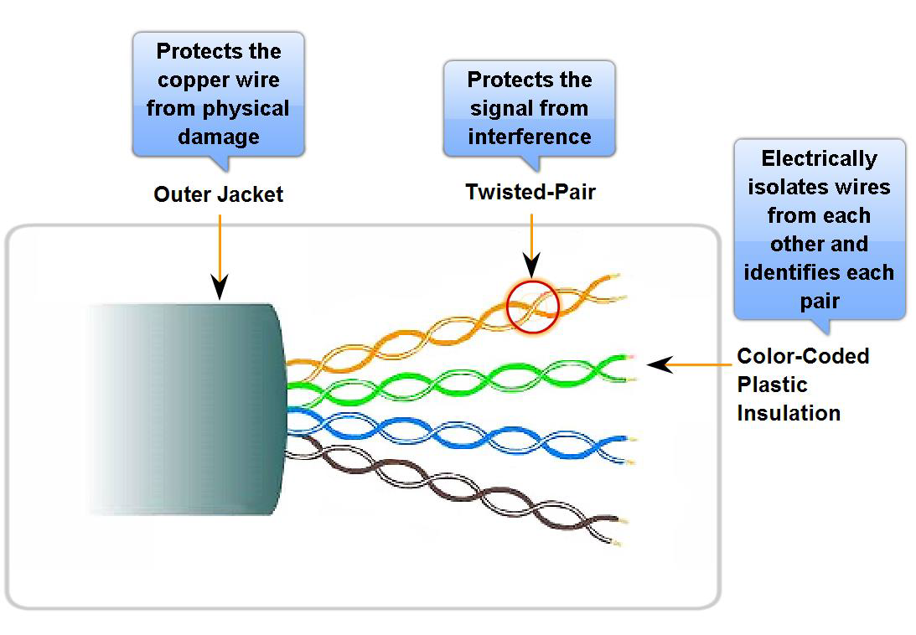
Unshielded Twisted Pair
UTP is a four-pair wire medium used in a variety of networks.
Each of the eight copper wires in the UTP cable is covered by insulating material.
Speed: 10-100-1000 Mbps*
Cost: Least Expensive
Media and connector size: Small
Maximum cable length: 100m * (Depending on the quality/category of cable)

Slide 49
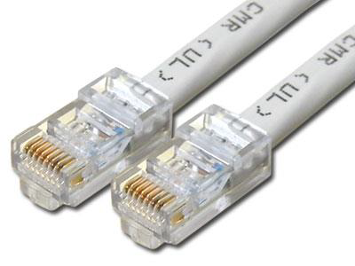
UTP Implementation
EIA/TIA specifies an RJ-45 connector for UTP cable.
The letters RJ stand for registered jack.

Slide 50
Inter-process Communication
Client-server
One server, many clients.
Server must execute continuously.
Client initiates communication.
Peer-to-peer (P2P)
Two processes communicating as equals.
Peer processes can be short-lived.

Slide 51
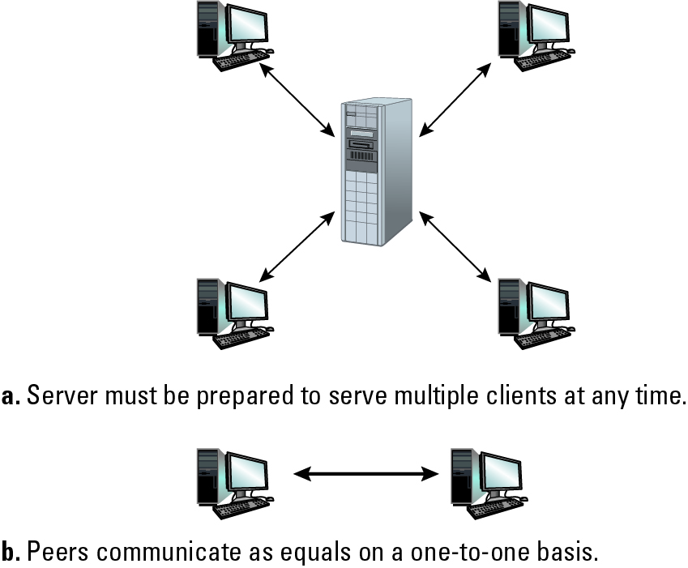
The Client/Server Model Compared to the Peer-to-Peer Model

Slide 52
Distributed Systems
Systems with parts that run on different computers
Cluster computing
Cluster differs from Cloud and Grid in that a cluster is a group of computers connected by a local area network (LAN).
Cluster is tightly coupled, whereas a Grid or a Cloud is loosely coupled.
Clusters are made up of machines with similar hardware, whereas clouds and grids are made up of machines with possibly very different hardware configurations.
Grid computing
Millions of home PCs (not connected to each other) work on a complex problem
Cloud and grid are more wide scale and can be geographically distributed.
FutureGrid
Cloud computing
Provide services, hide the details
Amazon’s Elastic Compute Cloud.
Google Drive, Gmail, Facebook, Youtube, Dropbox…

Slide 53
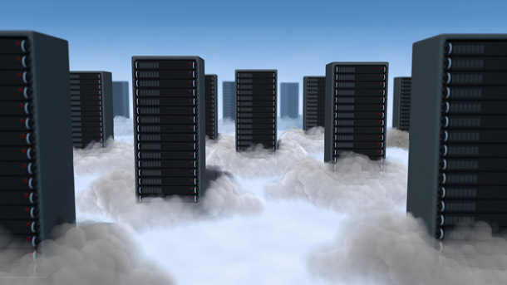
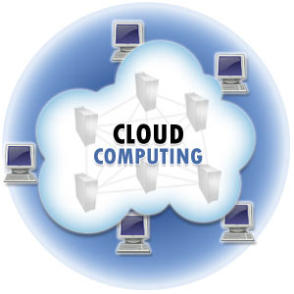
Cloud Computing
Cloud computing is Internet-based computing, whereby shared resources, software, and information are provided to computers and other devices on demand, like the electricity grid.
A Cloud is a type of parallel and distributed system consisting of a collection of interconnected and virtualized computers that are dynamically provisioned and presented as one or more unified computing resources based on service-level agreements established through negotiation between the service provider and consumers.

Slide 54
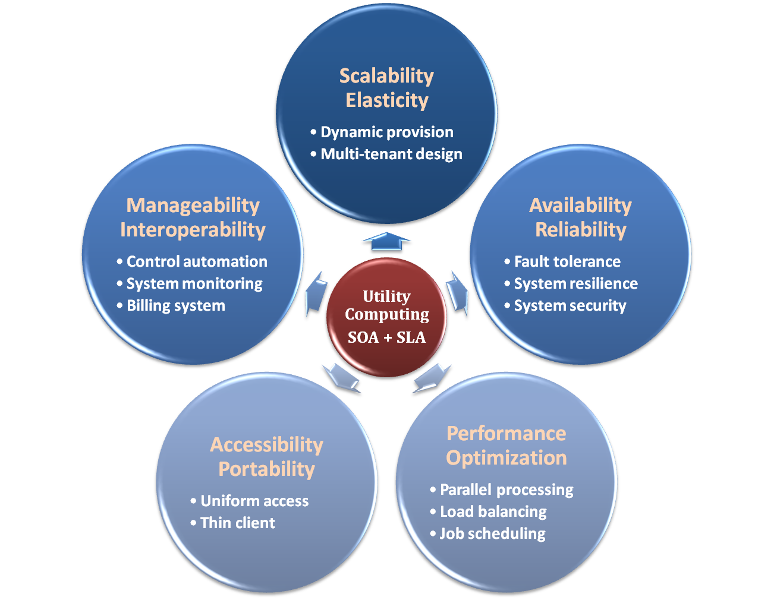
Properties & Characteristics

Slide 55
IaaS
Infrastructure as a Service – IaaS
The capability provided to the consumer is to provision processing, storage, networks, and other fundamental computing resources where the consumer is able to deploy and run arbitrary software, which can include operating systems and applications.
The consumer does not manage or control the underlying cloud infrastructure but has control over operating systems, storage, deployed applications, and possibly limited control of select networking components .
Examples :
Amazon EC2
Eucalyputs
OpenNebula

Slide 56
PaaS
Platform as a Service – PaaS
The capability provided to the consumer is to deploy onto the cloud infrastructure consumer-created or acquired applications created using programming languages and tools supported by the provider.
The consumer does not manage or control the underlying cloud infrastructure including network, servers, operating systems, or storage, but has control over the deployed applications and possibly application hosting environment configurations.
Examples :
Microsoft Windows Azure
Google App Engine
Hadoop(High Availability Distributed Object Oriented Platform)

Slide 57
SaaS
Software as a Service – SaaS
The capability provided to the consumer is to use the provider’s applications running on a cloud infrastructure. The applications are accessible from various client devices through a thin client interface such as a web browser (e.g., web-based email).
The consumer does not manage or control the underlying cloud infrastructure including network, servers, operating systems, storage, or even individual application capabilities, with the possible exception of limited user-specific application configuration settings.
Examples :
Google Apps (e.g., Gmail, Google Docs, Google sites, …etc)

Slide 58
The Internet
The Internet: An internet that spans the world.
Original goal was to develop a means of connecting networks that would not be disrupted by local disasters.
Today a commercial undertaking that links a worldwide combination of PANs, LANs, MANs, and WANs involving millions of computers.

Slide 59
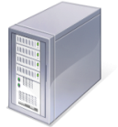

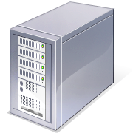
How Information Travel Through the Internet
When you connect to a Web site through an ISP and start exchanging information, there isn't a fixed connection between your computer and the Web server computer hosting the Web site.
Information is exchanged using the best possible path at that particular time.
Special computers called routers determine these paths, avoiding slow links and favoring fast ones.
Your Computer
Web Servers
ISP
Routers

Slide 60
Internet Architecture
Internet Service Provider (ISP)
Tier-1: ISP that has access to the entire Internet Region solely via its free and reciprocal peering agreements.
Tier-2: A Tier 2 ISP is an Internet Service Provider that purchases transit to reach some destination(s) within an Internet Region.
Access or tier-3 ISP: A network that solely purchases transit from other networks to reach the Internet.
Provides connectivity to the Internet.
Hot spot (wireless)
Telephone lines
Cable/Satellite systems DSL
Fiber optics

Slide 61
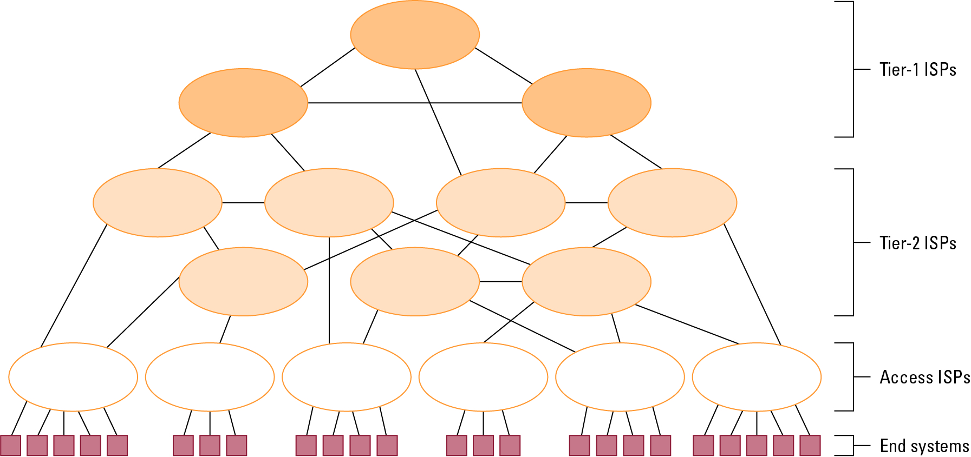
Internet Composition

Slide 62
Internet Addressing
IP address: pattern of 32 or 128 bits often represented in dotted decimal notation
IPv4
IPv6
Mnemonic address:
Domain names
Top-Level Domains
.org, .gov, .com, .mil, .net, .au, .ca, .biz, ….
Domain name system (DNS)
Name servers
DNS lookup

Slide 63
Internet Corporation for Assigned Names & Numbers (ICANN)
Allocates IP addresses to ISPs who then assign those addresses within their regions.
Oversees the registration of domains and domain names.

Slide 64

IP addressing: introduction
IP address: 32-bit identifier for host, router interface
interface: connection between host/router and physical link
router’s typically have multiple interfaces
host typically has one interface
IP addresses associated with each interface
223.1.1.1
223.1.2.1
223.1.1.2
223.1.1.4
223.1.2.9
223.1.2.2
223.1.1.3
223.1.3.27
223.1.3.1
223.1.3.2
223.1.1.1 = 11011111 00000001 00000001 00000001
223
1
1
1

Slide 65
Subnets
IP address:
subnet part - high order bits
host part - low order bits
What’s a subnet ?
device interfaces with same subnet part of IP address
can physically reach each other without intervening router
223.1.1.1
223.1.1.2
223.1.2.1
223.1.1.4
223.1.2.9
223.1.2.2
223.1.1.3
223.1.3.27
subnet
223.1.3.1
223.1.3.2
network consisting of 3 subnets

Slide 66
Subnets
223.1.1.0/24
to determine the subnets, detach each interface from its host or router, creating islands of isolated networks
each isolated network is called a subnet
223.1.2.0/24
223.1.1.1
223.1.1.2
223.1.2.1
223.1.1.4
223.1.2.9
223.1.2.2
223.1.1.3
223.1.3.27
subnet
223.1.3.1
223.1.3.2
223.1.3.0/24
subnet mask: /24

Slide 67
Subnets
223.1.1.2
223.1.1.1
223.1.1.4
how many?
223.1.1.3
223.1.9.2
223.1.7.0
223.1.9.1
223.1.7.1
223.1.8.1
223.1.8.0
223.1.2.6
223.1.3.27
223.1.2.1
223.1.2.2
223.1.3.1
223.1.3.2

Slide 68
IP addressing: CIDR
CIDR: Classless InterDomain Routing
subnet portion of address of arbitrary length
address format: a.b.c.d/x, where x is # bits in subnet portion of address
subnet
part
host
part
11001000 00010111 00010000 00000000
200.23.16.0/23

Slide 69
IP addresses: how to get one?
Q: How does a host get IP address?
hard-coded by system admin in a file
Windows: control-panel->network->configuration->tcp/ip->properties
UNIX: /etc/rc.config
DHCP: Dynamic Host Configuration Protocol: dynamically get address from as server
“plug-and-play”

Slide 70
DHCP: Dynamic Host Configuration Protocol
Goal: allow host to dynamically obtain its IP address from network server when it joins network
can renew its lease on address in use
allows reuse of addresses (only hold address while connected/“on”)
support for mobile users who want to join network (more shortly)
DHCP overview:
host broadcasts “DHCP discover” msg [optional]
DHCP server responds with “DHCP offer” msg [optional]
host requests IP address: “DHCP request” msg
DHCP server sends address: “DHCP ack” msg

Slide 71


DHCP client-server scenario
DHCP
server
223.1.1.0/24
223.1.1.1
223.1.2.1
223.1.1.2
arriving DHCP
client needs
address in this
network
223.1.1.4
223.1.2.9
223.1.2.2
223.1.1.3
223.1.3.27
223.1.2.0/24
223.1.3.1
223.1.3.2
223.1.3.0/24

Slide 72
DHCP client-server scenario
DHCP server: 223.1.2.5
DHCP discover
arriving
client
src : 0.0.0.0, 68
dest.: 255.255.255.255,67
yiaddr: 0.0.0.0
transaction ID: 654
DHCP offer
src: 223.1.2.5, 67
dest: 255.255.255.255, 68
yiaddrr: 223.1.2.4
transaction ID: 654
lifetime: 3600 secs
DHCP request
src: 0.0.0.0, 68
dest:: 255.255.255.255, 67
yiaddrr: 223.1.2.4
transaction ID: 655
lifetime: 3600 secs
DHCP ACK
src: 223.1.2.5, 67
dest: 255.255.255.255, 68
yiaddrr: 223.1.2.4
transaction ID: 655
lifetime: 3600 secs

Slide 73
DHCP: more than IP addresses
DHCP can return more than just allocated IP address on subnet:
address of first-hop router for client
name and IP address of DNS sever
network mask (indicating network versus host portion of address)

Slide 74
Domain name system
A system that can map a name to an address or an address to a name.
DNS is a protocol that can be used in different platforms.

Slide 75
Domain name system
Domain Name System
Distributed database
No centralization
Simple client/server architecture
UDP port 53, some implementations also use TCP
Hierarchical namespace
As opposed to original, flat namespace
e.g. .com → google.com → mail.google.com

Slide 76
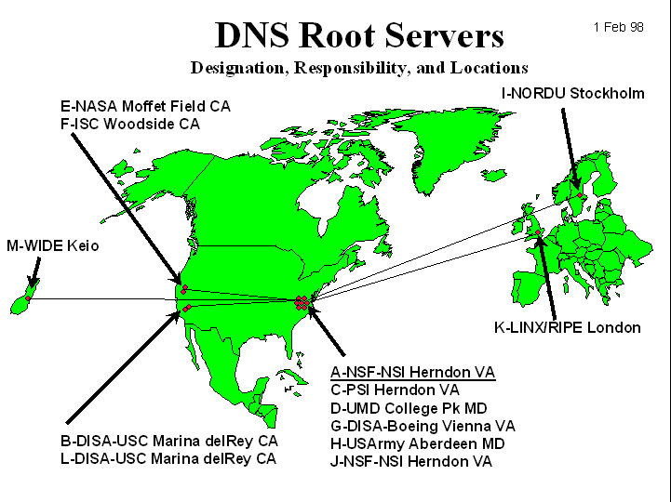
Domain name system
Contacted by local name server that can not resolve name
Root name server:
Knows the authoritative name server for main domain
~ 60 root name servers worldwide
Real-world application of anycast

Slide 77
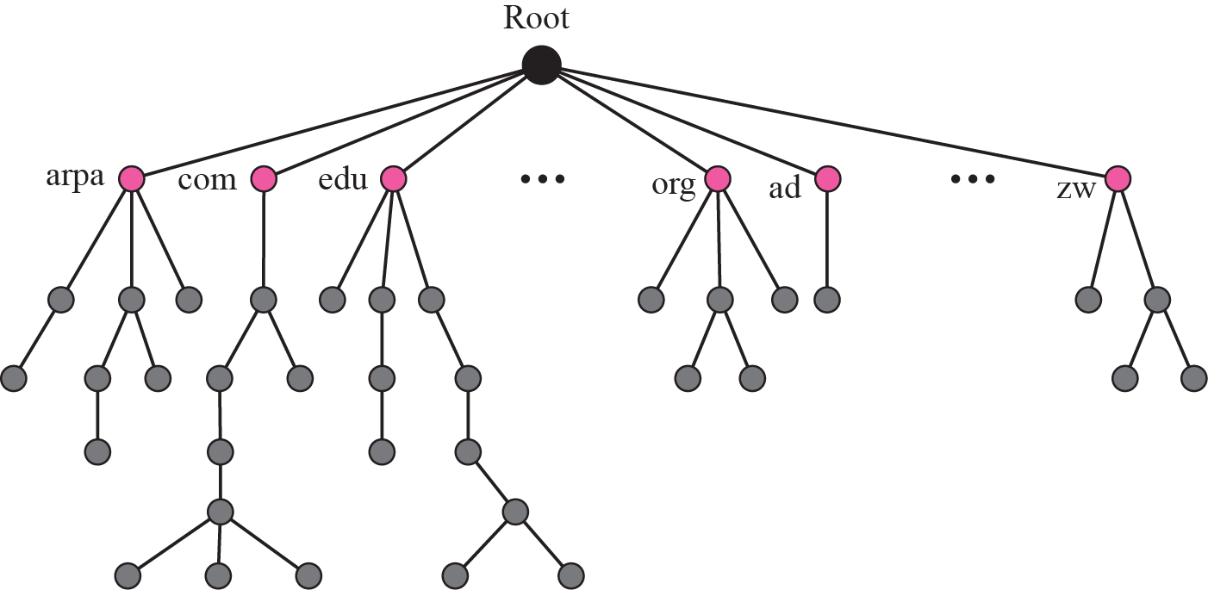
Domain name system

Slide 78
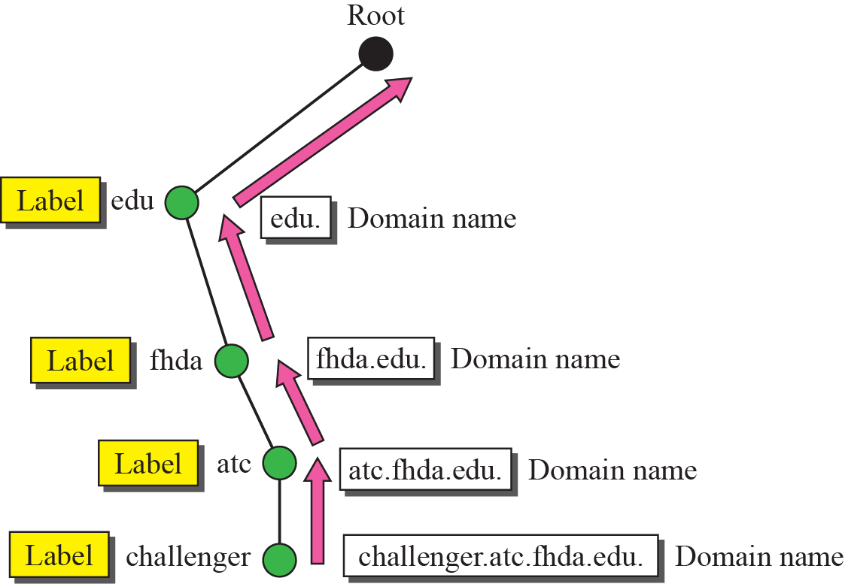
Domain name system

Slide 79
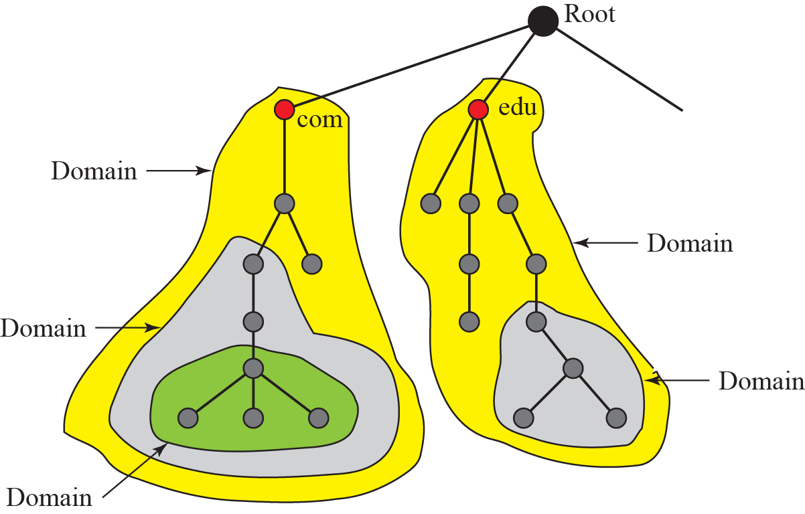
Domain name system

Slide 80
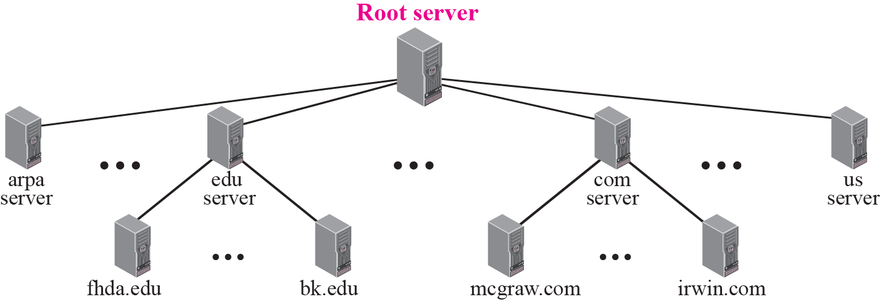
Domain name system

Slide 81
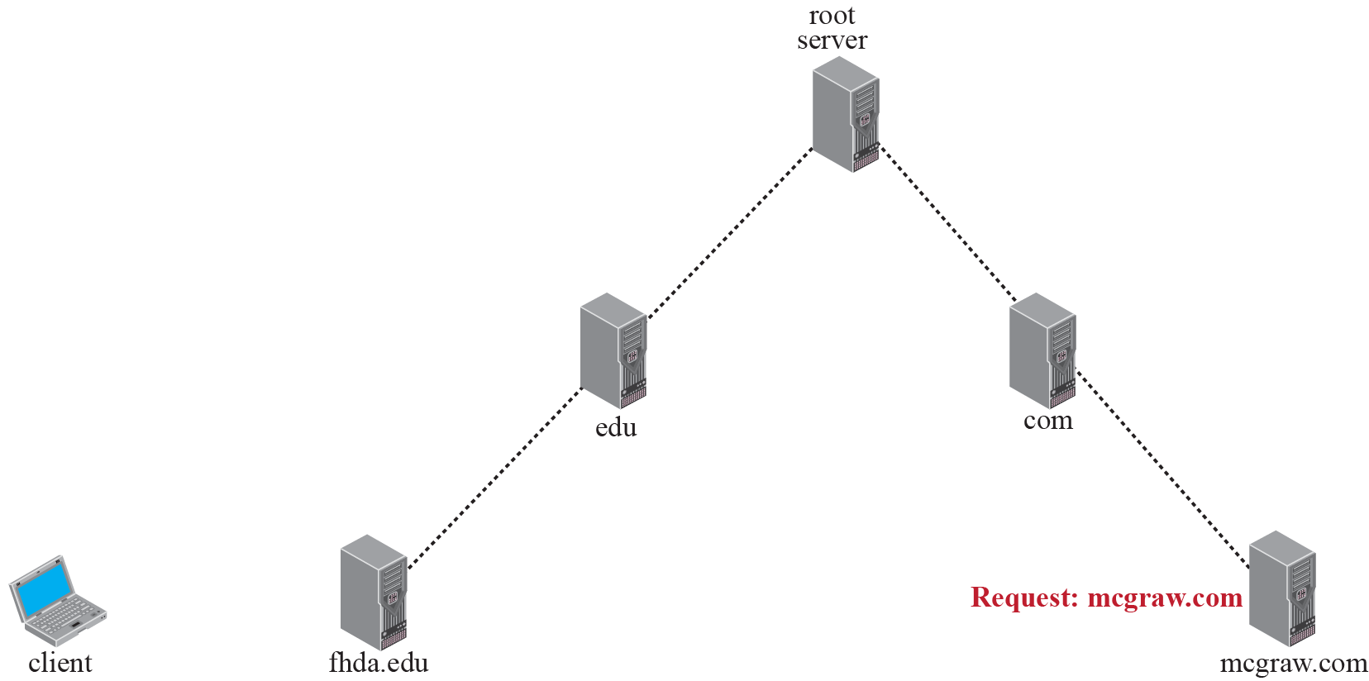
Resolving DNS - Iterative

Slide 82
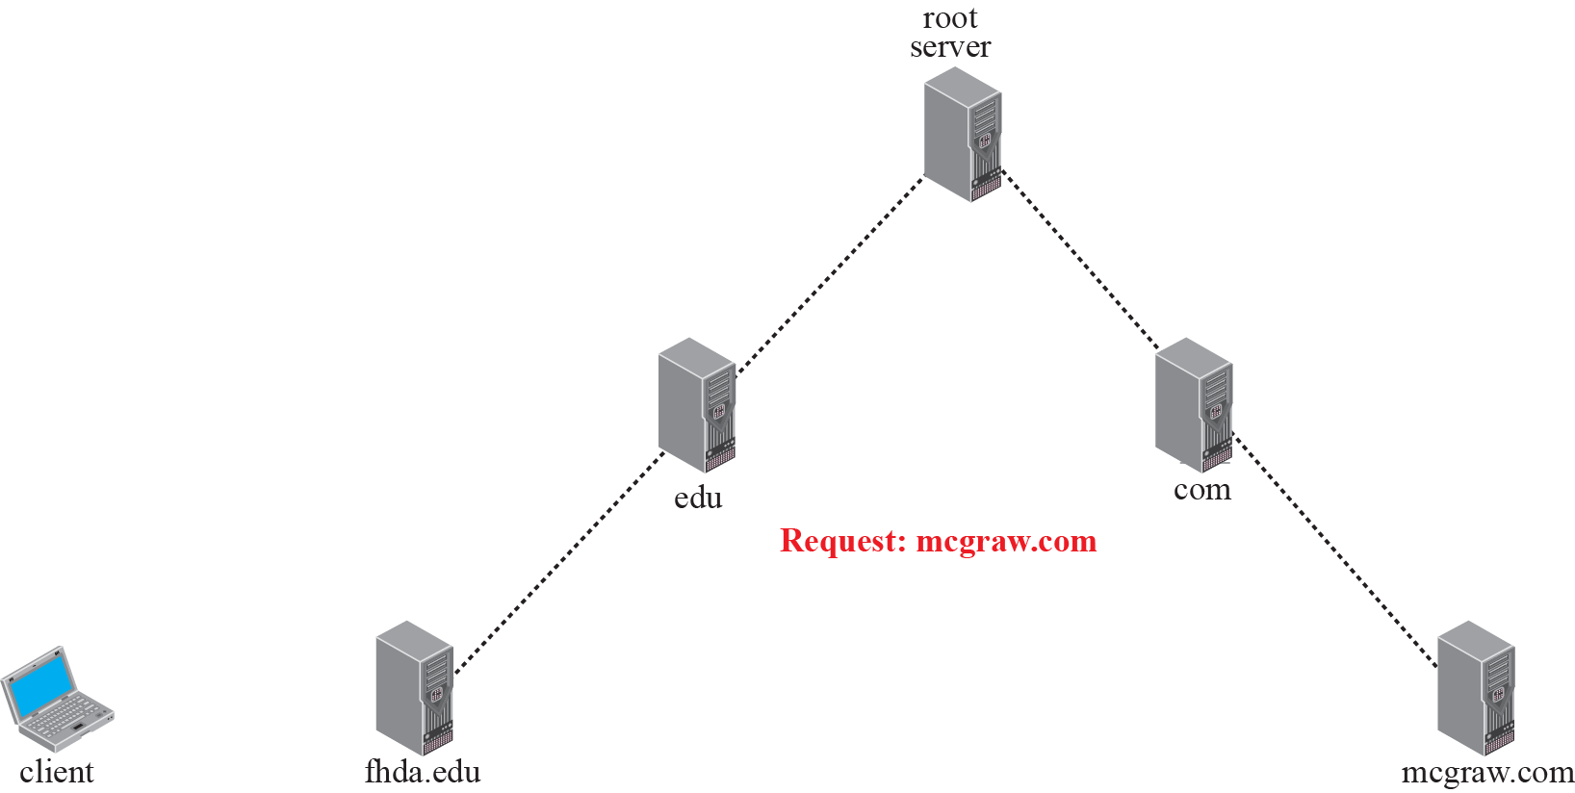
Resolving DNS - Recursive

Slide 83
Early Internet Applications
Network News Transfer Protocol (NNTP)
File Transfer Protocol (FTP)
Telnet and SSH
Hypertext Transfer Protocol (HTTP)
Electronic Mail (email)
Domain mail server collects incoming mail and transmits outing mail.
Mail server delivers collected incoming mail to clients via POP3 or IMAP.

Slide 84
SMTP Simple Mail Transfer Protocol
220 mail.tardis.edu SMTP Sendmail Gallifrey-1.0; Fri, 23 Aug 2413 14:34:10
HELO mail.skaro.gov
250 mail.tardis.edu Hello mail.skaro.gov, pleased to meet you
MAIL From: dalek@skaro.gov
250 2.1.0 dalek@skaro.gov... Sender ok
RCPT To: doctor@tardis.edu
250 2.1.5 doctor@tardis.edu... Recipient ok
DATA
354 Enter mail, end with "." on a line by itself
Subject: Extermination.
EXTERMINATE!
Regards, Dalek
.
250 2.0.0 r7NJYAEl028071 Message accepted for delivery
QUIT
221 2.0.0 mail.tardis.edu closing connection

Slide 85
More Recent Applications
Voice Over IP (VoIP)
Internet Multimedia Streaming
N-unicast
Multicast
On-demand streaming
Content delivery networks (CDNs)

Slide 86
World Wide Web
Hypertext combines internet technology with concept of linked-documents.
Embeds hyperlinks to other documents.
Browsers present materials to the user.
Webservers provide access to documents.
Documents are identified by URLs and transferred using HTTP.
URL: Uniform Resource Locator
URI: Uniform Resource Indentifier
A URI is an identifier for some resource, but a URL gives you specific information as to obtain that resource.

Slide 87
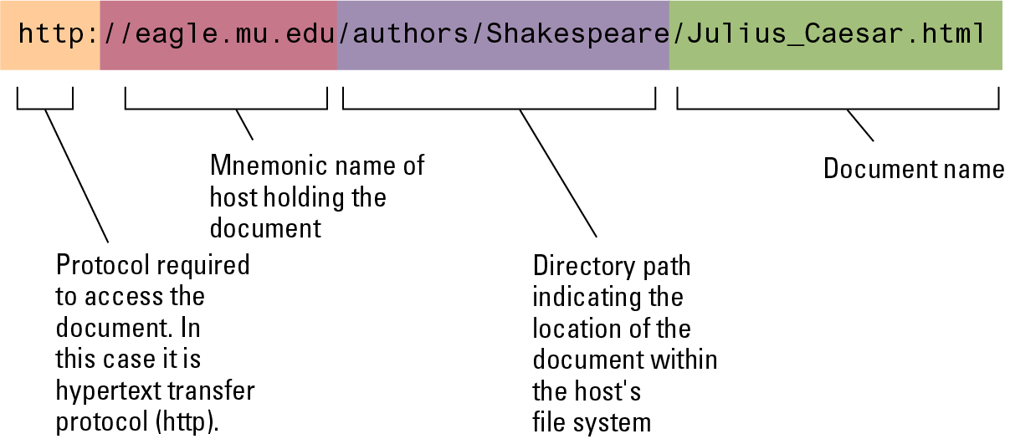
A Typical URL

Slide 88
Hypertext Markup Language (HTML)
Encoded as text file
Contains tags to communicate with browser
Appearance
<h1> to start a level one heading
<p> to start a new paragraph
Links to other documents and content
<a href = . . . >
Insert images
<img src = . . . >

Slide 89
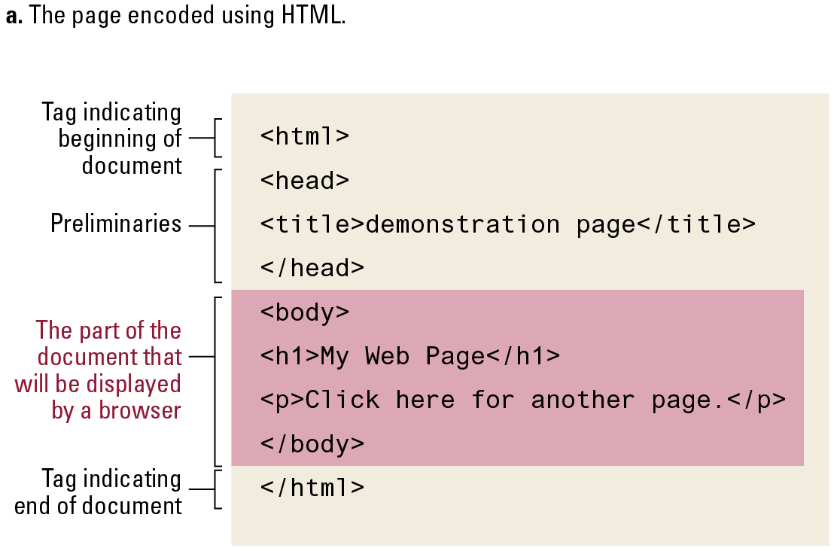
A Simple Webpage

Slide 90
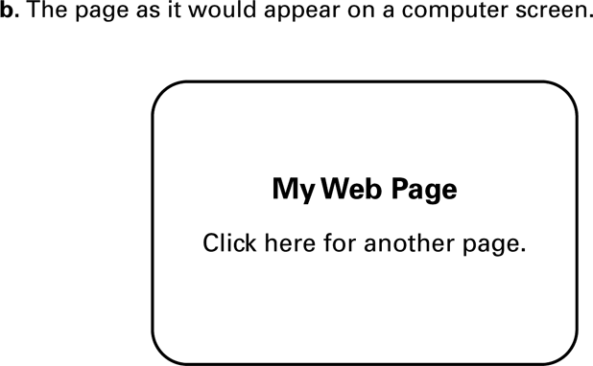
A Simple Webpage (continued)

Slide 91
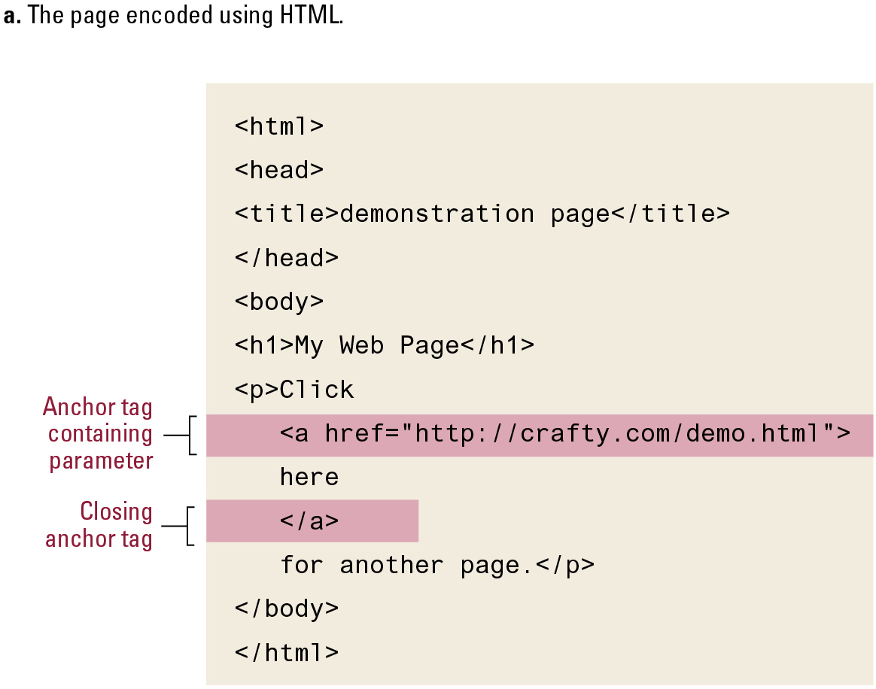
An Enhanced Simple Webpage

Slide 92

An Enhanced Simple Web Page (continued)

Slide 93
Extensible Markup Language (XML)
XML: A language for constructing markup languages similar to HTML
A descendant of SGML
Opens door to a World Wide Semantic Web

Slide 94
Using XML
<staff clef = “treble”> <key>C minor</key>
<time> 2/4 </time>
<measure> < rest> egth </rest> <notes> egth G, egth G, egth G </notes></measure>
<measure> <notes> hlf E </notes></measure>
</staff>

Slide 95

The First Two Bars of Beethoven’s Fifth Symphony

Slide 96


MathMLs
Mathematical Markup Language (MathML): Special form of markup language.
$x=\frac{−b±\sqrt{b^{2}−4ac}}{2a}$

Slide 97
Client Side vs Server Side
Client-side activities
Javascript
Macromedia Flash
Server-side activities
Common Gateway Interface (CGI)
Servlets
JavaServer Pages (JSP) / Active Server Pages (ASP)
PHP
Python, Perl

Slide 98
Internet Protocols
Control how messages are transferred over the Internet
This software must reside on every computer in the Internet
Accomplished by a multi-level hierarchy

Slide 99

Package-shipping Example

Slide 100

Internet packet encapsulation

Slide 101

Internet Software Layers
Application: Constructs message with address.
Transport: Chops message into packets.
Network: Handles routing through the Internet.
Link: Handles actual transmission of packets.

Slide 102
IP datagram format
IP protocol version
number
32 bits
total datagram
length (bytes)
header length
(bytes)
head.
len
type of
service
ver
length
for
fragmentation/
reassembly
“type” of data
flgs
fragment
offset
16-bit identifier
max number
remaining hops
(decremented at
each router)
time to
live
upper
layer
header
checksum
32 bit source IP address
upper layer protocol
to deliver payload to
32 bit destination IP address
options (if any)
e.g. timestamp,
record route
taken, specify
list of routers
to visit.
data
(variable length,
typically a TCP
or UDP segment)
how much overhead?
20 bytes of TCP
20 bytes of IP
= 40 bytes + app layer overhead

Slide 103
IP fragmentation, reassembly
fragmentation:
in: one large datagram
out: 3 smaller datagrams
Network links have MTU (max.transfer size) - largest possible link-level frame
different link types, different MTUs
Large IP datagram divided (“fragmented”) within net
one datagram becomes several datagrams
“reassembled” only at final destination
IP header bits used to identify, order related fragments
…
reassembly
…

Slide 104
IP fragmentation, reassembly
length
=4000
ID
=x
fragflag
=0
offset
=0
example:
4000 byte datagram
MTU = 1500 bytes
one large datagram becomes
several smaller datagrams
1480 bytes in data field
length
=1500
ID
=x
fragflag
=1
offset
=0
offset =
1480/8
length
=1500
ID
=x
fragflag
=1
offset
=185
length
=1040
ID
=x
fragflag
=0
offset
=370

Slide 105

TCP vs UDP Packet

Slide 106

Following a message through the Internet

Slide 107
TCP/IP Protocol Suite
Transport Layer
Transmission Control Protocol (TCP)
User Datagram Protocol (UDP)
Network Layer
Internet Protocol (IP)
IPv4
IPv6

Slide 108
TCP/IP Stack
A protocol stack is a group of protocols that all work together to allow software or hardware to perform a function.
The TCP/IP protocol stack is a good example.
It uses four layers that map to the OSI model.

Slide 109
TCP/IP Stack
Layer 1: Network Interface - This layer combines the Physical and Data layers and routes the data between devices on the same network. It also manages the exchange of data between the network and other devices.
Layer 2: Internet - This layer corresponds to the Network layer. The Internet Protocol (IP) uses the IP address, consisting of a Network Identifier and a Host Identifier, to determine the address of the device it is communicating with.

Slide 110
TCP/IP Stack
Layer 3: Transport - Corresponding to the OSI Transport layer, this is the part of the protocol stack where the Transport Control Protocol (TCP) can be found.
TCP works by asking another device on the network if it is willing to accept information from the local device.
Layer 4: Application - Layer 4 combines the Session, Presentation and Application layers of the OSI model.
Protocols for specific functions such as e-mail (Simple Mail Transfer Protocol, SMTP) and file transfer (File Transfer Protocol, FTP) reside at this level.

Slide 111

Choosing between TCP and UDP

Slide 112

Multiplexing Datagrams

Slide 113


Slide 114

RJ-45

Slide 115
Cybersecurity
Attacks
Malware (viruses, worms, Trojan horses, spyware, phishing software)
Denial of service (DoS)
Spam
Protection
Firewalls
Spam filters
Proxy Servers
Antivirus software

Slide 116
Encryption
HTTPS and SSL
Public-key Encryption
Public key: Used to encrypt messages
Private key: Used to decrypt messages
Certificates and Digital Signatures
Certificate authorities

Slide 117

Public-key Encryption

Slide 118
Legal approaches to network security
Computer Fraud and Abuse Act
Electronic Communication Privacy Act
USA PATRIOT Act
Communications Assistance for Law Enforcement Act
Anticybersquatting Consumer Protection Act

Slide 119
Security vs Privacy
Security: Can you keep things out of reach from others.
Privacy: Can you keep your things to yourself.

